Slide 1
DATA MINING ExPeriment
By HE WEI 2017.10.25

Slide 2
What is data mining?
After years of data mining there is still no unique answer to this question.
A tentative definition:
Data mining is the use of efficient techniques for the analysis of very large collections of data and the extraction of useful and possibly unexpected patterns in data.

Slide 3
Envrionment Installation
Classification with K-Nearest Neighbors using scikit-learn
Data Preprocessing using pipelines
Predicting Sports Winners with Decision Trees
Finding disambiguating terms in social media using Naive Bayes algorithm
Beating CAPTCHAs with Neural Networks
Recommending Movies Using Affinity Analysis
Clustering Analysis

Slide 4
Envrionment Installation
By HE WEI 2017.10.25

Slide 5
Envrionment Installation
Using Python and the IPython Notebook
In This Section, We Will Cover Installing Python And The Environment That We Will Use For Most Of The Book, The Ipython Notebook.
Furthermore, We Will Install The Numpy Module, Which We Will Use For The First Set Of Examples.
Installing Python
For this Experiement, we will be using Python 3.5, which is available for your system from the Python Organization's website:
https://www.python.org/downloads/.
There will be two major versions to choose from, Python 3.5 and Python 2.7.
Remember to download and install Python 3.5, which is the version tested
throughout this Experiement.

Slide 6
Envrionment Installation
PS:
Windows Users Will Need To Set An Environment Variable In Order To Use Python From The Command Line. First, Find Where Python 3 Is Installed; the Default Location Is C:\python35. Next, Enter This Command Into The Command Line (cmd Program):
Set The Enviornment To Pythonpath=%pythonpath%;c:\python35.
Remember To Change The C:\python35 If Python Is Installed Into A Different Directory.

Slide 7
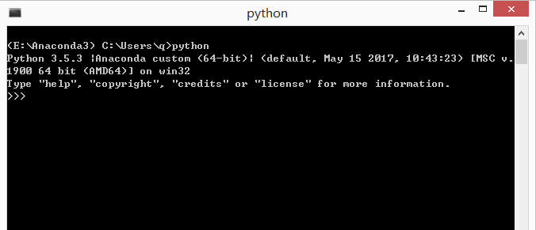
Envrionment Installation
Once you have Python running on your system, you should be able to open a command prompt and run the following code:

Slide 8
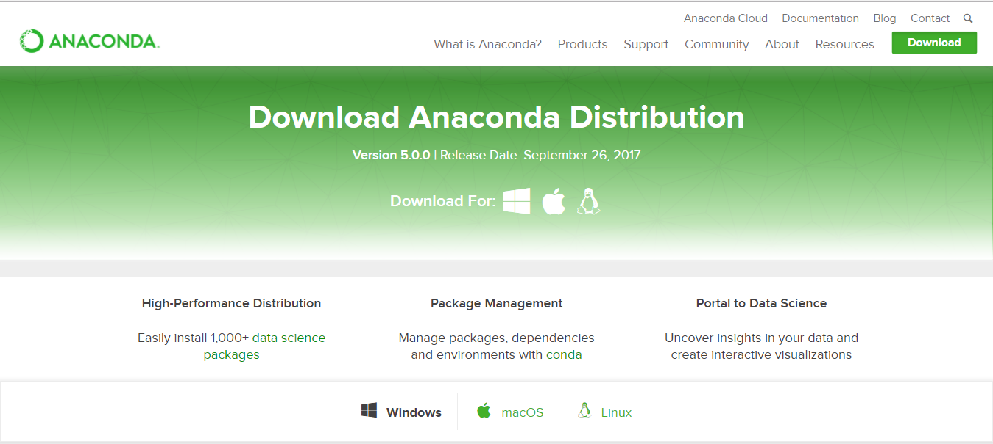
Envrionment Installation
In Here, I highly recommend that you install Anaconda to manage your Python
packages. Download address:https://www.anaconda.com/download/
And the Anaconda got GUI: Anaconda-Navigator and of course you can use command line, and API's here: https://docs.anaconda.com/

Slide 9
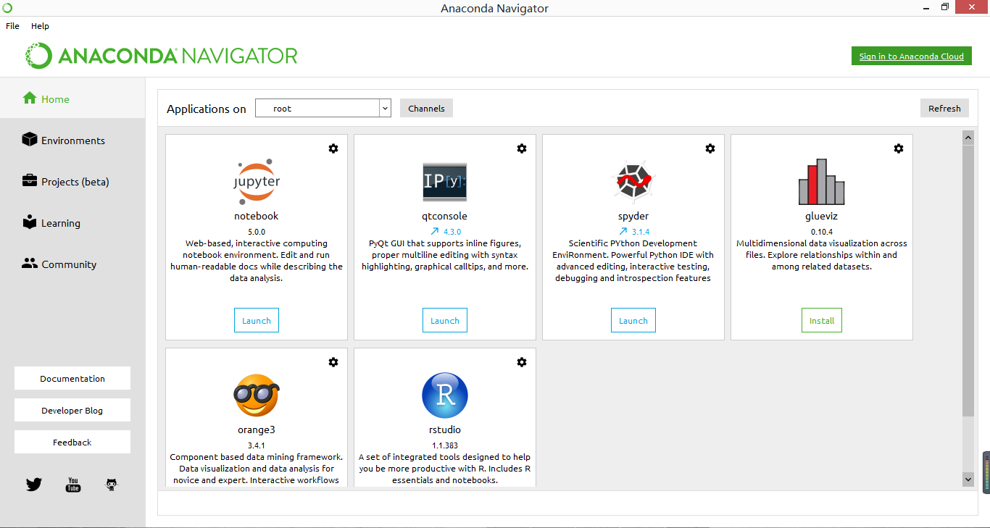
Envrionment Installation

Slide 10
Envrionment Installation
Installing IPython
IPython Is A Platform For Python Development That Contains A Number Of Tools And Environments For Running Python And Has More Features Than The Standard Interpreter. It Contains The Powerful Ipython Notebook, Which Allows You To Write Programs In A Web Browser. It Also Formats Your Code, Shows Output, And Allows You To Annotate Your Scripts. It Is A Great Tool For Exploring Datasets And We Will Be Using It As Our Main Environment For The Code In This Book.
To install IPython on your computer, you can type the following into a command line prompt (not into Python):
pip install ipython[all]
You will need administrator privileges to install this system-wide. If you do not want to (or can't) make system-wide changes, you can install it for just the current user by running this command:
pip install --user ipython[all]

Slide 11
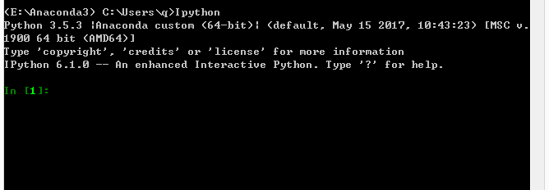
Envrionment Installation
Once you have IPython running on your system, you should be able to open a command prompt and run the following code:
With the IPython Notebook installed, you can launch it with the following:
ipython notebook

Slide 12
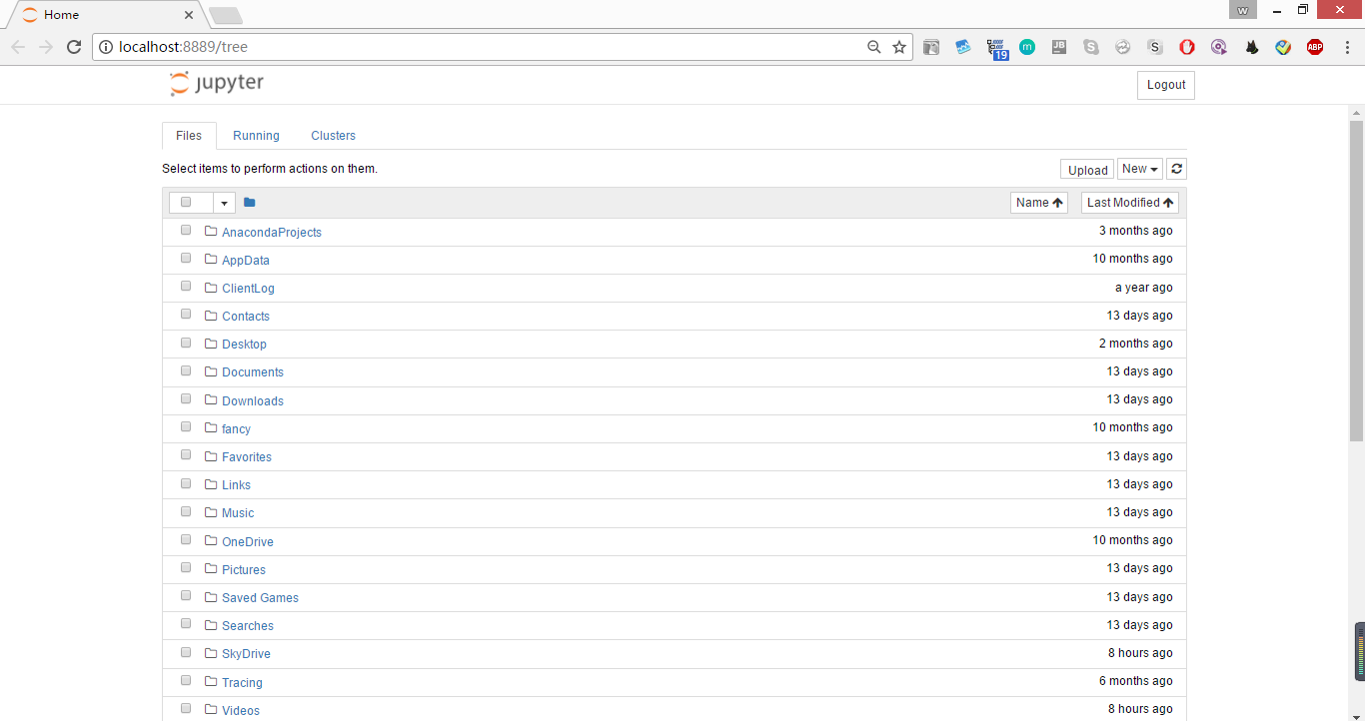
Envrionment Installation
This will do two things. First, it will create an IPython Notebook instance that will run in the command prompt you just used.
Second, it will launch your web browser and connect to this instance, allowing you to create a new notebook.
It will look something similar to the following screenshot (where home/bob will be replaced by your current working directory):
To stop the IPython Notebook from running, open the command prompt that has the instance running (the one you used earlier to run the IPython command).
Then, press Ctrl + C and you will be prompted Shutdown this notebook server (y/[n])?. Type y and press Enter and the IPython Notebook will shutdown.

Slide 13
Installing scikit-learn
Envrionment Installation
The Scikit-learn Package Is A Machine Learning Library, Written In Python. It
contains Numerous Algorithms, Datasets, Utilities, And Frameworks For Performing
machine Learning. Built Upon The Scientific Python Stack, Scikit-learn Users Such As the Numpy And Scipy Libraries Are Often Optimized For Speed. This Makes Scikit-learn fast And Scalable In Many Instances And Also Useful For All Skill Ranges From Beginners to Advanced Research Users. We Will Cover More Details Of Scikit-learn In here, classifying With Scikit-learn Estimators.
To Install Scikit-learn, You Can Use The Pip Utility That Comes With
python 3, Which Will Also Install The Numpy And Scipy Libraries If You Do Not
already Have Them. Open A Terminal With Administrator/root Privileges And
enter The Following Command:
pip install -u scikit-learn
Windows users may need to install the numpy and scipy
libraries before installing scikit-learn.
Users of major Linux distributionsmay wish to install official package from their package manager. Not all distributions have the latest versions of scikit-learn, so check the version before installing it. Minimum version needed here is 0.14.

Slide 14
Classification with K-Nearest Neighbors using scikit-learn
By HE WEI 2017.10.25

Slide 15

K Nearest Neighbor
The scikit-learn library is a collection of data mining algorithms, written in Python
and using a common programming interface.
This allows users to easily try different algorithms as well as utilize standard tools for doing effective testing and parameter searching. There are a large number of algorithms and utilities in scikit-learn.
In this experiment, we focus on setting up a good framework for running data mining procedures. This will be used in later experiments, which are all focused on applications and techniques to use in those situations.
The key concepts introduced in this chapter are as follows:
• Estimators: This is to perform classification, clustering, and regression
• Transformers: This is to perform preprocessing and data alterations
• Pipelines: This is to put together your workflow into a replicable format
http://scikit-learn.org/stable/

Slide 16
scikit-learn estimators
K Nearest Neighbor
Estimators are scikit-learn's abstraction, allowing for the standardized
implementation of a large number of classification algorithms.
Estimators are used for classification. Estimators have the following two main functions:
• fit(): This performs the training of the algorithm and sets internal
parameters. It takes two inputs, the training sample dataset and the
corresponding classes for those samples.
• predict(): This predicts the class of the testing samples that is given as
input. This function returns an array with the predictions of each input
testing sample.
There are a large number of estimators in scikit-learn. These include support vector machines (SVM), random forests, and neural networks.
In this experiment, we will use a different estimator from scikit-learn: nearest neighbor.

Slide 17

K Nearest Neighbor
For this chapter, you will need to install a new library called matplotlib
You can just install it in command line by:
pip install matplotlib

Slide 18
K Nearest Neighbor
Nearest neighbors
Nearest neighbors is perhaps one of the most intuitive algorithms in the set of standard data mining algorithms.
To predict the class of a new sample, we look through the training dataset for the samples that are most similar to our new sample.
We take the most similar sample and predict the class that the majority of those samples have.
As an example, we wish to predict the class of the triangle, based on which class it is more similar to (represented here by having similar objects closer together).
We seek the three nearest neighbors, which are two diamonds and one square.
There are more diamonds than circles, and the predicted class for the triangle is, therefore, a diamond:

Slide 19
K Nearest Neighbor
Nearest neighbors can be used for nearly any dataset-however, it can be very
computationally expensive to compute the distance between all pairs of samples.
For example if there are 10 samples in the dataset, there are 45 unique distances
to compute.
However, if there are 1000 samples, there are nearly 500,000! Various methods exist for improving this speed dramatically;

Slide 20
K Nearest Neighbor
Distance metrics
1.Euclidean distance
The most common distance metric that the people are aware of is Euclidean
distance, which is the real-world distance. If you were to plot the points on a graph and measure the distance with a straight ruler, the result would be the Euclidean distance. A little more formally, it is the square root of the sum of the squared distances for each feature.
Euclidean distance is intuitive, but provides poor accuracy if some features have larger values than others. It also gives poor results when lots of features have a value of 0, known as a sparse matrix.
There are other distance metrics in use; two commonly employed ones are the Manhattan and Cosine distance.

Slide 21
K Nearest Neighbor
2.Manhattan distance
The Manhattan distance is the sum of the absolute differences in each feature (with no use of square distances).
Intuitively, it can be thought of as the number of moves a rook piece (or castle) in chess would take to move between the points, if it were limited to moving one square at a time.
While the Manhattan distance does suffer if some features have larger values than others, the effect is not as dramatic as in the case of Euclidean.
3.Cosine distance
The Cosine distance is better suited to cases where some features are larger than others and when there are lots of zeros in the dataset.
Intuitively, we draw a line from the origin to each of the samples, and measure the angle between those lines.

Slide 22
K Nearest Neighbor
This can be seen in the following diagram:
In this example, each of the grey circles are in the same distance from the white
circle. In (a), the distances are Euclidean, and therefore, similar distances fit around
a circle. This distance can be measured using a ruler. In (b), the distances are
Manhattan, also called City Block.
We compute the distance by moving across rows and columns, similar to how a Rook (Castle) in Chess moves. Finally, in (c), we have the Cosine distance that is measured by computing the angle between the lines drawn from the sample to the vector, and ignore the actual length of the line.

Slide 23
K Nearest Neighbor
The distance metric chosen can have a large impact on the final performance!!
For example, if you have many features, the Euclidean distance between random samples approaches the same value. This makes it hard to compare samples as the distances are the same!
Manhattan distance can be more stable in some circumstances, but if some features have very large values, this can overrule lots of similarities in other features.
Finally, Cosine distance is a good metric for comparing
items with a large number of features, but it discards some information about the length of the vector, which is useful in some circumstances.
For this experiement, we will stay with Euclidean distance

Slide 24

Loading the dataset
The dataset we are going to use is called Ionosphere, which is the recording of many high-frequency antennas. The aim of the antennas is to determine whether there is a structure in the ionosphere and a region in the upper atmosphere. Those that have a structure are deemed good, while those that do not are deemed bad.
The aim of this application is to build a data mining classifier that can determine whether an image is good or bad.
the dataset in a directory called Data in your home folder.

Slide 25
For each row in the dataset, there are 35 values. The first 34 are measurements taken from the 17 antennas (two values for each antenna). The last is either 'g' or 'b'; that stands for good and bad, respectively.
Start the IPython Notebook server and create a new notebook called Ionosphere Nearest Neighbors for this chapter.
First, we load up the NumPy and csv libraries that we will need for our code:
import numpy as np
To load the dataset, we first get the filename of the dataset. First, get the folder the dataset is stored in from your data folder:
data_filename = os.path.join(data_folder, "Ionosphere","ionosphere.data")

Slide 26
We then create the X and y NumPy arrays to store the dataset in. The sizes of these arrays are known from the dataset. Don't worry if you don't know the size of future datasets—we will use other methods to load the dataset in future chapters and you won't need to know this size beforehand:
X = np.zeros((351, 34), dtype='float')
y = np.zeros((351,), dtype='bool')
The dataset is in a Comma-Separated Values (CSV) format, which is a commonly used format for datasets. We are going to use the csv module to load this file.
Import it and set up a csv reader object:
with open(data_filename, 'r') as input_file:
reader = csv.reader(input_file)

Slide 27
Next, we loop over the lines in the file. Each line represents a new set of measurements, which is a sample in this dataset. We use the enumerate function to get the line's index as well, so we can update the appropriate sample in the dataset (X):
for i, row in enumerate(reader):
We take the first 34 values from this sample, turn each into a float, and save that to our dataset:
data = [float(datum) for datum in row[:-1]]
X[i] = data
Finally, we take the last value of the row and set the class. We set it to 1 (or True) if it is a good sample, and 0 if it is not:
y[i] = row[-1] == 'g'
We now have a dataset of samples and features in X, and the corresponding
classes in y, as we did in the classification example in experiement1

Slide 28
Moving towards a standard workflow
Estimators in scikit-learn have two main functions: fit() and predict().
We train the algorithm using the fit method and our training set. We evaluate it using the predict method on our testing set.
First, we need to create these training and testing sets. As before, import and run the train_test_split function:
from sklearn.cross_validation import train_test_split
X_train, X_test, y_train, y_test = train_test_split(X, y, random_
state=14)
Then, we import the nearest neighbor class and create an instance for it. We leave the parameters as defaults for now, and will choose good parameters later in this.

Slide 29
By default, the algorithm will choose the five nearest neighbors to predict
the class of a testing sample:
from sklearn.neighbors import KNeighborsClassifier
estimator = KNeighborsClassifier()
After creating our estimator, we must then fit it on our training dataset. For the nearest neighbor class, this records our dataset, allowing us to find the nearest neighbor for a new data point, by comparing that point to the training dataset:
estimator.fit(X_train, y_train)
We then train the algorithm with our test set and evaluate with our testing set:
y_predicted = estimator.predict(X_test)
accuracy = np.mean(y_test == y_predicted) * 100
print("The accuracy is {0:.1f}%".format(accuracy))

Slide 30
This scores 86.4 percent accuracy, which is impressive for a default algorithm and just a few lines of code! Most scikit-learn default parameters are chosen explicitly to work well with a range of datasets. However, you should always aim to choose parameters based on knowledge of the application experiment.
Running the algorithm
In our earlier experiments, we set aside a portion of the dataset as a testing set,
with the rest being the training set. We train our algorithm on the training set and
evaluate how effective it will be based on the testing set.
However, what happens if we get lucky and choose an easy testing set? Alternatively, what if it was particularly troublesome? We can discard a good model due to poor results resulting from such an "unlucky" split of our data.
The cross-fold validation framework is a way to address the problem of choosing a testing set and a standard methodology in data mining.
The process works by doing a number of experiments with different training and testing splits, but using each sample in a testing set only once.

Slide 31
The procedure is as follows:
1. Split the entire dataset into a number of sections called folds.
2. For each fold in the dataset, execute the following steps:
Set that fold aside as the current testing set
Train the algorithm on the remaining folds
Evaluate on the current testing set
3. Report on all the evaluation scores, including the average score.
4. In this process, each sample is used in the testing set only once.
This reduces (but doesn't completely eliminate) the likelihood of
choosing lucky testing sets.

Slide 32
Cross Validation
We can import scikit-learn library now in our IPython Notebook
from sklearn.cross_validation import cross_val_score
Next, we use this function, passing the original (full) dataset and classes:
scores = cross_val_score(estimator, X, y, scoring='accuracy')
average_accuracy = np.mean(scores) * 100
print("The average accuracy is {0:.1f}%".format(average_accuracy))
This gives a slightly more modest result of 82.3 percent, but it is still quite good
considering we have not yet tried setting better parameters.
In the next section, we will see how we would go about changing the parameters to achieve a better outcome.

Slide 33
Setting parameters
Almost all data mining algorithms have parameters that the user can set. This is often a cause of generalizing an algorithm to allow it to be applicable in a wide variety of circumstances.
Setting these parameters can be quite difficult, as choosing good parameter values is often highly reliant on features of the dataset.
The nearest neighbor algorithm has several parameters, but the most important one is that of the number of nearest neighbors to use when predicting the class of an unseen attribution.
In scikit-learn, this parameter is called n_neighbors.
In the following figure, we show that when this number is too low, a randomly
labeled sample can cause an error.

Slide 34
In contrast, when it is too high, the actual nearest neighbors have a lower effect on the result:

Slide 35
In the figure (a), on the left-hand side, we would usually expect the test sample (the triangle) to be classified as a circle.
However, if n_neighbors is 1, the single red diamond in this area (likely a noisy sample) causes the sample to be predicted as being a diamond, while it appears to be in a red area.
In the figure (b), on the right-hand side, we would usually expect the test sample to be classified as a diamond.
However, if n_neighbors is 7, the three nearest neighbors (which are all diamonds) are overridden by the large number of circle samples.

Slide 36
If we want to test a number of values for the n_neighbors parameter, for example, each of the values from 1 to 20, we can rerun the experiment many times by setting n_neighbors and observing the result:
avg_scores = []
all_scores = []
parameter_values = list(range(1, 21)) # Include 20
for n_neighbors in parameter_values:
estimator = KNeighborsClassifier(n_neighbors=n_neighbors)
scores = cross_val_score(estimator, X, y, scoring='accuracy')
Compute and store the average in our list of scores. We also store the full set of
scores for later analysis:
avg_scores.append(np.mean(scores))
all_scores.append(scores)

Slide 37
We can then plot the relationship between the value of n_neighbors and the
accuracy.
First, we tell the IPython Notebook that we want to show plots inline
in the notebook itself:
%matplotlib inline
We then import pyplot from the matplotlib library and plot the parameter values alongside average scores:
from matplotlib import pyplot as plt plt.plot(parameter_values,
avg_scores, '-o')

Slide 38
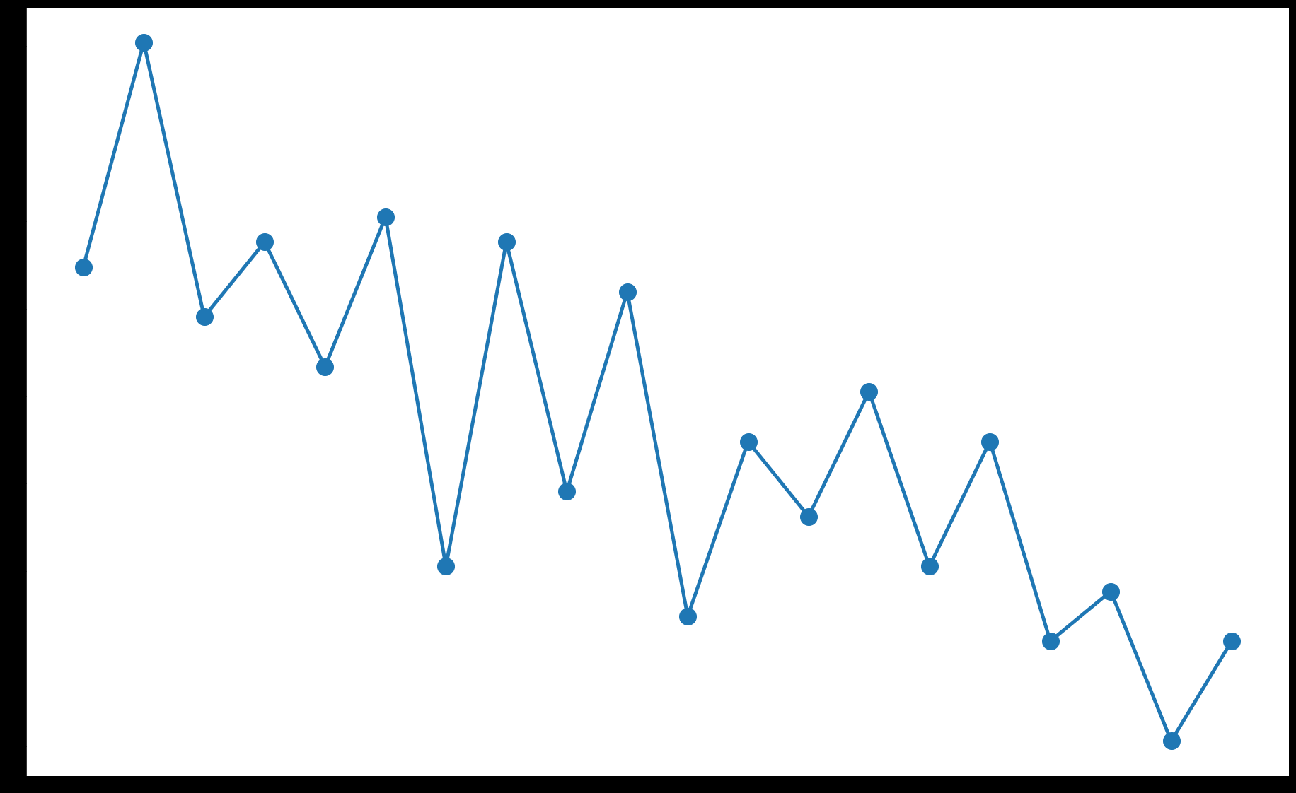
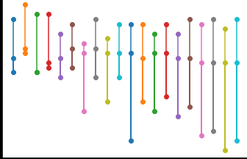
Cross Validation Result
(x-N, Y-Accuracy)
Selecting N Result
(x-N, Y-Accuracy)
While there is a lot of variance, the plot shows a decreasing trend as the number of neighbors increases.

Slide 39
Data Preprocessing using pipelines
By HE WEI 2017.10.25

Slide 40
Data Preprocessing
For a mathematical-based algorithm to compare each of these features, the
differences in the scale, range, and units can be difficult to interpret. If we used the above features in many algorithms, the weight would probably be the most influential feature due to only the larger numbers and not anything to do with the actual effectiveness of the feature.
One of the methods to overcome this is to use a process called preprocessing
to normalize the features so that they all have the same range, or are put into
categories like small, medium and large.
Suddenly, the large difference in the types of features has less of an impact on the algorithm, and can lead to large increases in the accuracy.

Slide 41
Preprocessing can also be used to choose only the more effective features, create new features, and so on.
Preprocessing in scikit-learn is done through Transformer objects, which take a dataset in one form and return an altered dataset after some transformation of the data. These don't have to be numerical, as Transformers are also used to extract features-however, in this section, we will stick with preprocessing.
An example
We can show an example of the problem by breaking the Ionosphere dataset.
While this is only an example, many real-world datasets have problems of this
form.
First, we create a copy of the array so that we do not alter the original dataset:
X_broken = np.array(X)

Slide 42
Next, we break the dataset by dividing every second feature by 10:
X_broken[:,::2] /= 10
In theory, this should not have a great effect on the result. After all, the values
for these features are still relatively the same. The major issue is that the scale has changed and the odd features are now larger than the even features.
We can see the effect of this by computing the accuracy:
estimator = KNeighborsClassifier()
original_scores = cross_val_score(estimator, X, y, scoring='accuracy')
print("The original average accuracy for is {0:.1f}%".format(np.mean(original_scores) * 100))
broken_scores = cross_val_score(estimator, X_broken, y,scoring='accuracy')
print("The 'broken' average accuracy for is {0:.1f}%".format(np.mean(broken_scores) * 100))

Slide 43
This gives a score of 82.3 percent for the original dataset, which drops down to 71.5 percent on the broken dataset. We can fix this by scaling all the features to the range 0 to 1.
Standard preprocessing
The preprocessing we will perform for this experiment is called feature-based
normalization through the MinMaxScaler class. Continuing with the IPython
notebook from the rest of this experiement, first, we import this class:
from sklearn.preprocessing import MinMaxScaler
This class takes each feature and scales it to the range 0 to 1. The minimum value is replaced with 0, the maximum with 1, and the other values somewhere in between.

Slide 44
To apply our preprocessor, we run the transform function on it. While MinMaxScaler doesn't, some transformers need to be trained first in the same way that the classifiers do. We can combine these steps by running the fit_transform function instead:
X_transformed = MinMaxScaler().fit_transform(X)
Here, X_transformed will have the same shape as X. However, each column will have a maximum of 1 and a minimum of 0.

Slide 45
There are various other forms of normalizing in this way, which is effective for other applications and feature types:
Ensure the sum of the values for each sample equals to 1, using sklearn.
preprocessing.Normalizer
Force each feature to have a zero mean and a variance of 1, using sklearn.
preprocessing.StandardScaler, which is a commonly used starting point for
normalization
Turn numerical features into binary features, where any value above
a threshold is 1 and any below is 0, using sklearn.preprocessing. Binarizer
We will use combinations of these preprocessors in later chapters, along with other types of Transformers object.

Slide 46
Putting it all together
We can now create a workflow by combining the code from the previous sections, using the broken dataset previously calculated:
X_transformed = MinMaxScaler().fit_transform(X_broken)
estimator = KNeighborsClassifier()
transformed_scores = cross_val_score(estimator, X_transformed, y,
scoring='accuracy')
print("The average accuracy for is {0:.1f}%".format(np.mean(transformed_scores) * 100))

Slide 47
This gives us back our score of 82.3 percent accuracy. The MinMaxScaler resulted in features of the same scale, meaning that no features overpowered others by simply being bigger values.
While the Nearest Neighbor algorithm can be confused with larger features, some algorithms handle scale differences better.
In contrast, some are much worse!

Slide 48
Pipelines
As experiments grow, so does the complexity of the operations. We may split up our dataset, binarize features, perform feature-based scaling, perform sample-based scaling, and many more operations.
Pipelines are a construct that addresses these problems (and others, which we will see in the next experiment).
Pipelines store the steps in your data mining workflow. They can take your raw data in, perform all the necessary transformations, and then create
a prediction.
This allows us to use pipelines in functions such as cross_val_score,
where they expect an estimator.
First, import the Pipeline object:
from sklearn.pipeline import Pipeline

Slide 49
Pipelines take a list of steps as input, representing the chain of the data mining
application. The last step needs to be an Estimator, while all previous steps are
Transformers.
The input dataset is altered by each Transformer, with the output of one step being the input of the next step.
Finally, the samples are classified by the last step's estimator. In our pipeline, we have two steps:
1. Use MinMaxScaler to scale the feature values from 0 to 1
2. Use KNeighborsClassifier as the classification algorithms
Each step is then represented by a tuple ('name', step). We can then create our pipeline:
scaling_pipeline = Pipeline([('scale', MinMaxScaler()), ('predict', KNeighborsClassifier())])

Slide 50
The key here is the list of tuples.
The first tuple is our scaling step and the second tuple is the predicting step. We give each step a name: the first we call scale and the second we call predict, but you can choose your own names.
The second part of the tuple is the actual Transformer or estimator object.
Running this pipeline is now very easy, using the cross validation code from before:
scores = cross_val_score(scaling_pipeline, X_broken, y,
scoring='accuracy')
print("The pipeline scored an average accuracy for is {0:.1f}%".
format(np.mean(transformed_scores) * 100))

Slide 51
This gives us the same score as before (82.3 percent), which is expected, as we are effectively running the same steps.
In later experiments, we will use more advanced testing methods, and setting up pipelines is a great way to ensure that the code complexity does not grow unmanageably.

Slide 52
Predicting Sports Winners with Decision Trees
By HE WEI 2017.10.25

Slide 53
Loading the dataset
In this chapter, we will look at predicting the winner of games of the National
Basketball Association (NBA).
Matches in the NBA are often close and can be decided in the last minute, making predicting the winner quite difficult. Many sports share this characteristic, whereby the expected winner could be beaten by another team on the right day.
Various research into predicting the winner suggests that there may be an upper limit to sports outcome prediction accuracy which, depending on the sport, is between 70 percent and 80 percent accuracy.
There is a significant amount of research being performed into sports prediction, often through data mining or statistics-based methods.

Slide 54
The data we will be using is the match history data for the NBA for the 2013-2014 season. The website http://Basketball-Reference.com contains a significant number of resources and statistics collected from the NBA and other leagues.
This will download a CSV (short for Comma Separated Values) file containing the results of the 1,319 games in the regular season for the NBA.
We will load the file with the pandas (short for Python Data Analysis) library,
which is an incredibly useful library for manipulating data.
Python also contains a built-in library called csv that supports reading and writing CSV files.
However, we will use pandas, which provides more powerful functions that we will use later in here for creating new features.
pip3 install pandas

Slide 55
Using pandas to load the dataset
The pandas library is a library for loading, managing, and manipulating data.
It handles data structures behind-the-scenes and supports analysis methods, such as computing the mean.
We can load the dataset using the read_csv function:
import pandas as pd
dataset = pd.read_csv(data_filename)
The result of this is a pandas Dataframe, and it has some useful functions that we will use later on. Looking at the resulting dataset, we can see some issues.

Slide 56
Type the following and run the code to see the first five rows of the dataset:
dataset.ix[:5]
Here's the output:
This is actually a usable dataset, but it contains some problems that we will fix up soon.

Slide 57
Cleaning up the dataset
After looking at the output, we can see a number of problems:
• The date is just a string and not a date object
• The first row is blank
• From visually inspecting the results, the headings aren't complete or correct
These issues come from the data, and we could fix this by altering the data itself. However, in doing this, we could forget the steps we took or misapply them; that is,we can't replicate our results.
As with the previous section where we used pipelines to track the transformations we made to a dataset, we will use pandas to applytransformations to the raw data itself.

Slide 58
The pandas.read_csv function has parameters to fix each of these issues, which we can specify when loading the file. We can also change the headings after loading the file, as shown in the following code:
dataset = pd.read_csv(data_filename, parse_dates=["Date"],
skiprows=[0,])
dataset.columns = ["Date", "Score Type", "Visitor Team","VisitorPts", "Home Team", "HomePts", "OT?", "Notes"]
The results have significantly improved, as we can see if we print out the resulting data frame:
dataset.ix[:5]

Slide 59
The output is as follows:
Even in well-compiled data sources such as this one, you need to make some adjustments. Different systems have different nuances, resulting in data files that are not quite compatible with each other.
Now that we have our dataset, we can compute a baseline. A baseline is an accuracy that indicates an easy way to get a good accuracy. Any data mining solution should beat this.
In each match, we have two teams: a home team and a visitor team. An obvious baseline, called the chance rate, is 50 percent. Choosing randomly will (over time) result in an accuracy of 50 percent.

Slide 60
Extracting new features
We can now extract our features from this dataset by combining and comparing
the existing data.
First up, we need to specify our class value, which will give classification algorithm something to compare against to see if its prediction is correct or not. This could be encoded in a number of ways;
however, for thisapplication, we will specify our class as 1 if the home team wins and 0 if the visitor team wins. In basketball, the team with the most points wins.
So, while the data set doesn't specify who wins, we can compute it easily.
We can specify the data set by the following:
dataset["HomeWin"] = dataset["VisitorPts"] < dataset["HomePts"]

Slide 61
We then copy those values into a NumPy array to use later for our scikit-learn
classifiers. There is not currently a clean integration between pandas and scikit-learn, but they work nicely together through the use of NumPy arrays.
While we will use pandas to extract features, we will need to extract the values to use them with scikit-learn:
y_true = dataset["HomeWin"].values
The preceding array now holds our class values in a format that scikit-learn can read.
We can also start creating some features to use in our data mining. While sometimes we just throw the raw data into our classifier, we often need to derive continuous numerical or categorical features.

Slide 62
The first two features we want to create to help us predict which team will win
are whether either of those two teams won their last game.
This would roughly approximate which team is playing well.
We will compute this feature by iterating through the rows in order and recording
which team won. When we get to a new row, we look up whether the team won the last time we saw them.
We first create a (default) dictionary to store the team's last result:
from collections import defaultdict
won_last = defaultdict(int)

Slide 63
The key of this dictionary will be the team and the value will be whether they won their previous game. We can then iterate over all the rows and update the current row with the team's last result:
for index, row in dataset.iterrows():
home_team = row["Home Team"]
visitor_team = row["Visitor Team"]
row["HomeLastWin"] = won_last[home_team]
row["VisitorLastWin"] = won_last[visitor_team]
dataset.ix[index] = row
Note that the preceding code relies on our dataset being in chronological order. Our dataset is in order; however, if you are using a dataset that is not in order, you will need to replace dataset.iterrows() with dataset.sort("Date").iterrows().

Slide 64
We then set our dictionary with the each team's result (from this row) for the next time we see these teams. The code is as follows:
won_last[home_team] = row["HomeWin"]
won_last[visitor_team] = not row["HomeWin"]
After the preceding code runs, we will have two new features: HomeLastWin and VisitorLastWin. We can have a look at the dataset. There isn't much point in looking at the first five games though. Due to the way our code runs, we didn't have data for them at that point.
Therefore, until a team's second game of the season, we won't know their current form. We can instead look at different places in the list.

Slide 65
The following code will show the 20th to the 25th games of the season:
dataset.ix[20:25]
Here's the output:
You can change those indices to look at other parts of the data, as there are over 1000 games in our dataset!
Currently, this gives a false value to all teams (including the previous year's
champion!) when they are first seen.

Slide 66
Decision trees
Decision trees are a class of supervised learning algorithm like a flow chart that consists of a sequence of nodes, where the values for a sample are used to make a decision on the next node to go to.

Slide 67
As with most classification algorithms, there are two components:
• The first is the training stage, where a tree is built using training data.While the nearest neighbor algorithm from the previous chapter did not have a training phase, it is needed for decision trees.
In this way, the nearest neighbor algorithm is a lazy learner, only doing any work when it needs to make a prediction. In contrast, decision trees, like most classification methods, are eager learners, undertaking work at the training stage.
• The second is the predicting stage, where the trained tree is used to predict the classification of new samples.
Using the previous example tree, a data point of ["is raining", "very windy"] would be classed as "bad weather".

Slide 68
The scikit-learn package implements the CART (Classification and Regression
Trees) algorithm as its default decision tree class, which can use both categorical and continuous features.
Parameters in decision trees
One of the most important features for a decision tree is the stopping criterion. As a tree is built, the final few decisions can often be somewhat arbitrary and rely on only a small number of samples to make their decision.
Using such specific nodes can results in trees that significantly overfit the training data. Instead, a stopping criterion can be used to ensure that the decision tree does not reach this exactness.
Instead of using a stopping criterion, the tree could be created in full and then
trimmed. This trimming process removes nodes that do not provide much
information to the overall process. This is known as pruning.

Slide 69
Pruning
The decision tree implementation in scikit-learn provides a method to stop the building of a tree using the following options:
• min_samples_split: This specifies how many samples are needed in order to create a new node in the decision tree
• min_samples_leaf: This specifies how many samples must be resulting from a node for it to stay
The first dictates whether a decision node will be created, while the second dictates whether a decision node will be kept.

Slide 70
Another parameter for decision tress is the criterion for creating a decision.
Gini impurity and Information gain are two popular ones:
• Gini impurity: This is a measure of how often a decision node would
incorrectly predict a sample's class
• Information gain: This uses information-theory-based entropy to indicate how much extra information is gained by the decision node
Using decision trees
We can import the DecisionTreeClassifier class and create a decision tree using scikit-learn:
from sklearn.tree import DecisionTreeClassifier
clf = DecisionTreeClassifier(random_state=14)
We used 14 for our random_state again

Slide 71
We now need to extract the dataset from our pandas data frame in order to use it with our scikit-learn classifier.
We do this by specifying the columns we wish to use and using the values parameter of a view of the data frame.
The following code creates a dataset using our last win values for both the home team and the visitor team:
X_previouswins = dataset[["HomeLastWin", "VisitorLastWin"]].values
Decision trees are estimators, as introduced before, Classifying with scikit-learn Estimators, and therefore have fit and predict methods. We can also use the cross_val_score method to get the average score (as we did previously):
scores = cross_val_score(clf, X_previouswins, y_true, scoring='accuracy')
print("Accuracy: {0:.1f}%".format(np.mean(scores) * 100))

Slide 72
This scores 56.1 percent: we are better than choosing randomly! We should be able to do better. Feature engineering is one of the most difficult tasks in data mining, and choosing good features is key to getting good outcomes—more so than choosing the right algorithm!
Sports outcome prediction
We may be able to do better by trying other features. We have a method for
testing how accurate our models are. The cross_val_score method allows us
to try new features.
There are many possible features we could use, but we will try the following
questions:
• Which team is considered better generally?
• Which team won their last encounter?
We will also try putting the raw teams into the algorithm to check whether the
algorithm can learn a model that checks how different teams play against each other.

Slide 73
Putting it all together
For the first feature, we will create a feature that tells us if the home team is generally better than the visitors. To do this, we will load the standings (also called a ladder in some sports) from the NBA in the previous season. A team will be considered better if it ranked higher in 2013 than the other team.
To obtain the standings data, perform the following steps (Already got):
1. Navigate to http://www.basketball-reference.com/leagues/NBA_2013_
standings.html in your web browser.
2. Select Expanded Standings to get a single list for the entire league.
3. Click on the Export link.
4. Save the downloaded file in your data folder.

Slide 74
Back in your IPython Notebook, enter the following lines into a new cell. You'll need to ensure that the file was saved into the location pointed to by the data_folder variable. The code is as follows:
standings_filename = os.path.join(data_folder,"leagues_NBA_2013_standings_expanded-standings.csv")
standings = pd.read_csv(standings_filename, skiprows=[0,1])
You can view the ladder by just typing standings into a new cell and running the code:
Standings

Slide 75
The output is as follows:
Next, we create a new feature using a similar pattern to the previous feature.
We iterate over the rows, looking up the standings for the home team and visitor
team. The code is as follows:
dataset["HomeTeamRanksHigher"] = 0
for index, row in dataset.iterrows():
home_team = row["Home Team"]
visitor_team = row["Visitor Team"]

Slide 76
As an important adjustment to the data, a team was renamed between the 2013 and 2014 seasons (but it was still the same team).
This is an example of one of the many different things that can happen when trying to integrate data! We will need to adjust the team lookup, ensuring we get the correct team's ranking:
if home_team == "New Orleans Pelicans":
home_team = "New Orleans Hornets"
elif visitor_team == "New Orleans Pelicans":
visitor_team = "New Orleans Hornets"
Now we can get the rankings for each team.
We then compare them and update the feature in the row:
home_rank = standings[standings["Team"] ==
home_team]["Rk"].values[0]
visitor_rank = standings[standings["Team"] ==
visitor_team]["Rk"].values[0]
row["HomeTeamRanksHigher"] = int(home_rank > visitor_rank)
dataset.ix[index] = row

Slide 77
Next, we use the cross_val_score function to test the result. First, we extract
the dataset:
X_homehigher = dataset[["HomeLastWin", "VisitorLastWin",
"HomeTeamRanksHigher"]].values
Then, we create a new DecisionTreeClassifier and run the evaluation:
clf = DecisionTreeClassifier(random_state=14)
scores = cross_val_score(clf, X_homehigher, y_true,
scoring='accuracy')
print("Accuracy: {0:.1f}%".format(np.mean(scores) * 100))
This now scores 60.3 percent—even better than our previous result. Can we
do better?
Next, let's test which of the two teams won their last match. While rankings can give some hints on who won (the higher ranked team is more likely to win), sometimes teams play better against other teams.

Slide 78
There are many reasons for this – for example, some teams may have strategies that work against other teams really well.
Following our previous pattern, we create a dictionary to store the winner of the past game and create a new feature in our data frame. The code is as follows:
last_match_winner = defaultdict(int)
dataset["HomeTeamWonLast"] = 0
Then, we iterate over each row and get the home team and visitor team:
for index, row in dataset.iterrows():
home_team = row["Home Team"]
visitor_team = row["Visitor Team"]
We want to see who won the last game between these two teams regardless of which team was playing at home.
Therefore, we sort the team names alphabetically, giving us a consistent key for those two teams:
teams = tuple(sorted([home_team, visitor_team]))

Slide 79
We look up in our dictionary to see who won the last encounter between the two teams.
Then, we update the row in the dataset data frame:
row["HomeTeamWonLast"] = 1 if last_match_winner[teams] ==
row["Home Team"] else 0
dataset.ix[index] = row
Finally, we update our dictionary with the winner of this game in order to compute the feature for the next time these two teams meet:
winner = row["Home Team"] if row["HomeWin"] else row ["Visitor Team"]
last_match_winner[teams] = winner

Slide 80
Next, we will create a dataset with just our two features. You could try different combinations of features to see if they obtain different results. The code is as follows:
X_lastwinner = dataset[["HomeTeamRanksHigher", "HomeTeamWonLast"]].values
clf = DecisionTreeClassifier(random_state=14)
scores = cross_val_score(clf, X_lastwinner, y_true,
scoring='accuracy')
print("Accuracy: {0:.1f}%".format(np.mean(scores) * 100))
This scores 60.6 percent . Our results are getting better and better.
Finally, we will check what happens if we throw a lot of data at the decision tree, and see if it can learn an effective model anyway. We will enter the teams into the tree and check whether a decision tree can learn to incorporate that information.

Slide 81
While decision trees are capable of learning from categorical features, the
implementation in scikit-learn requires those features to be encoded first.
We can use the LabelEncoder transformer to convert between the string-based team names into integers.
The code is as follows:
from sklearn.preprocessing import LabelEncoder
encoding = LabelEncoder()
We will fit this transformer to the home teams so that it learns an integer
representation for each team:
encoding.fit(dataset["Home Team"].values)

Slide 82
We extract all of the labels for the home teams and visitor teams, and then join them to create a matrix encoding both the home team and the
visitor team for each game. The code is as follows:
home_teams = encoding.transform(dataset["Home Team"].values)
visitor_teams = encoding.transform(dataset["Visitor Team"].values)
X_teams = np.vstack([home_teams, visitor_teams]).T
These integers can be fed into the decision tree, but they will still be interpreted as continuous features by DecisionTreeClassifier.
For example, teams may be allocated integers 0 to 16. The algorithm will see teams 1 and 2 as being similar, while teams 4 and 10 will be different—but this makes no sense as all.
All of the teams are different from each other—two teams are either the same or they are not!

Slide 83
To fix this inconsistency, we use the OneHotEncoder transformer to encode these integers into a number of binary features. Each binary feature will be a single value for the feature.
For example, if the NBA team Chicago Bulls is allocated as integer 7 by the LabelEncoder, then the seventh feature returned by the OneHotEncoder will be a 1 if the team is Chicago Bulls and 0 for all other teams.
This is done for every possible value, resulting in a much larger dataset. The code is as follows:
from sklearn.preprocessing import OneHotEncoder
onehot = OneHotEncoder()
We fit and transform on the same dataset, saving the results:
X_teams_expanded = onehot.fit_transform(X_teams).todense()

Slide 84
Next, we run the decision tree as before on the new dataset:
clf = DecisionTreeClassifier(random_state=14)
scores = cross_val_score(clf, X_teams_expanded, y_true,
scoring='accuracy')
print("Accuracy: {0:.1f}%".format(np.mean(scores) * 100))
This scores an accuracy of 60 percent. The score is better than the baseline, but not as good as before.
It is possible that the larger number of features were not handled properly by the decision trees.
For this reason, we will try changing the algorithm and see if that helps. Data mining can be an iterative process of trying new algorithms and features.

Slide 85
Finding disambiguating terms in social media using NaivE Bayes algorithm
By HE WEI 2017.10.25

Slide 86
Disambiguation
We can compare the information stored in a book with that stored in a large database to see the difference.
In the book, there are characters, themes, places, and lots of information. However, the book needs to be read and, more importantly, interpreted to gain this information.
The database sits on your server with column names and data types. All the information is there and the level of interpretation needed is quite
low. Information about the data, such as its type or meaning is called metadata, and text lacks it. A book also contains some metadata in the form of a table of contents and index but the degree is significantly lower than that of a database.

Slide 87
One of the problems is the term disambiguation. When a person uses the word bank, is this a financial message or an environmental message (such as river bank)? This type of disambiguation is quite easy in many circumstances for humans (although there are still troubles), but much harder for computers to do.
In this Experiment, we will look at disambiguating the use of the term Python on Twitter's stream. A message on Twitter is called a tweet and is limited to 140 characters. This means there is little room for context. There isn't much metadata available although hashtags are often used to denote the topic of the tweet.
When people talk about Python, they could be talking about the following things:
• The programming language Python
• Monty Python, the classic comedy group
• The snake Python
• A make of shoe called Python

Slide 88
There can be many other things called Python. The aim of our experiment is to take a tweet mentioning Python and determine whether it is talking about the programming language, based only on the content of the tweet.

Slide 89
Downloading data from a social network
We are going to download a corpus of data from Twitter and use it to sort out
spam from useful content. Twitter provides a robust API for collecting information from its servers and this API is free for small-scale usage.
When you are logged in, go to https://apps.twitter.com/ and click on
Create New App.
Create a name and description for your app, along with a website address.
If you don't have a website to use, insert a placeholder. Leave the Callback URL field blank for this app—we won't need it. click on Create your Twitter application.
Next, we need a library to talk to Twitter. There are many options; the one I like is simply called twitter, and is the official Twitter Python library:
pip install twitter
Note: The data is already provided in this experiments in json format!!

Slide 90
For those who are insterested in twitter API, you can download yourself:
For those who are not insterested, you can skip the two following slides
import twitter
consumer_key = "<Your Consumer Key Here>"
consumer_secret = "<Your Consumer Secret Here>"
access_token = "<Your Access Token Here>"
access_token_secret = "<Your Access Token Secret Here>"
authorization = twitter.OAuth(access_token, access_token_secret,
consumer_key, consumer_secret)
We are going to get our tweets from Twitter's search function. We will create
a reader that connects to twitter using our authorization, and then use that
reader to perform searches.
In the Notebook, we set the filename where the tweets will be stored:
import os
output_filename = os.path.join(os.path.expanduser("~"),"Data", "twitter", "python_tweets.json")
import json
t = twitter.Twitter(auth=authorization)

Slide 91
We then open our output file for writing. We open it for appending—this allows
us to rerun the script to obtain more tweets. We then use our Twitter connection to perform a search for the word Python.
This code takes the tweet, uses the json library to create a string representation using the dumps function, and then writes it to the file.
It then creates a blank line under the tweet so that we can easily distinguish where one tweet starts and ends in our file:
with open(output_filename, 'a') as output_file:
search_results = t.search.tweets(q="python", count=100)['statuses']
for tweet in search_results:
if 'text' in tweet:
output_file.write(json.dumps(tweet))
output_file.write("\n\n")
Running this for a few minutes will result in 100 tweets being added to the
output file.

Slide 92
Loading and classifying the dataset
After we have collected a set of tweets (our dataset), we need labels to perform classification. We are going to label the dataset by setting up a form in an IPython Notebook to allow us to enter the labels.
To parse it, we can use the json library but we will have to first split the file by newlines to get the actual tweet objects themselves.
Set up a new IPython Notebook (I called mine ch6_label_twitter) and enter
the dataset's filename.
This is the same filename in which we saved the data in the previous section. We also define the filename that we will use to save the labels to.
The code is as follows:
import os
input_filename = os.path.join(os.path.expanduser("~"), "Data","twitter", "python_tweets.json")
labels_filename = os.path.join(os.path.expanduser("~"), "Data","twitter", "python_classes.json")

Slide 93
import json
tweets = []
with open(input_filename) as inf:
for line in inf:
if len(line.strip()) == 0:
continue
tweets.append(json.loads(line))
We will use the IPython Notebook's ability to embed HTML and talk between JavaScript and Python to create a viewer of tweets to allow us to easily and quickly classify the tweets as spam or not.
labels = []
if os.path.exists(labels_filename):
with open(labels_filename) as inf:
labels = json.load(inf)

Slide 94
Next, we create a simple function that will return the next tweet that needs to be labeled. We can work out which is the next tweet by finding the first one that hasn't yet been labeled. The code is as follows:
def get_next_tweet():
return tweet_sample[len(labels)]['text']
Notebooks allow us to use magic functions to embed HTML and JavaScript (among other things) directly into the Notebook itself. Start a new cell with the following line at the top:
%%javascript
function set_label(label){
var kernel = IPython.notebook.kernel;
kernel.execute("labels.append(" + label + ")");
load_next_tweet();
}

Slide 95
function load_next_tweet(){
var code_input = "get_next_tweet()";
var kernel = IPython.notebook.kernel;
var callbacks = { 'iopub' : {'output' : handle_output}};
kernel.execute(code_input, callbacks, {silent:false});
}
function handle_output(out){
var res = out.content.data["text/plain"];
$("div#tweet_text").html(res);
}
Our form will have a div that shows the next tweet to be labeled, which we will give the ID #tweet_text. We also create a textbox to enable us to capture key presses (otherwise, the Notebook will capture them and JavaScript won't do anything).
This allows us to use the keyboard to set labels of 1 or 0, which is faster than using the mouse to click buttons—given that we will need to label at least 100 tweets.

Slide 96
We are going to use a different magic function now, %%html. Unsurprisingly, this magic function allows us to directly embed HTML into our Notebook. In a new cell, start with this line:
%%html
<div name="tweetbox">
Instructions: Click in textbox. Enter a 1 if the tweet is
relevant, enter 0 otherwise.<br>
Tweet: <div id="tweet_text" value="text"></div><br>
<input type=text id="capture"></input><br>
</div>
<script>
$("input#capture").keypress(function(e) {
if(e.which == 48) {
set_label(0);
$("input#capture").val("");
}else if (e.which == 49){
set_label(1);
$("input#capture").val("");
}
});load_next_tweet();
</script>

Slide 97
When you finish all of this, simply save the labels to the output filename we defined earlier for the class values:
with open(labels_filename, 'w') as outf:
json.dump(labels, outf)
You can call the preceding code even if you haven't finished. Any labeling you have done to that point will be saved.
Running this Notebook again will pick up where you left off and you can keep labeling your tweets.

Slide 98
Text transformers
Now that we have our dataset, how are we going to perform data mining on it?
Text-based datasets include books, essays, websites, manuscripts, programming
code, and other forms of written expression.
All of the algorithms we have seen so far deal with numerical or categorical features, so how do we convert our text into a format that the algorithm can deal with?
There are a number of measurements that could be taken. For instance, average
word and average sentence length are used to predict the readability of a document.
However, there are lots of feature types such as word occurrence which we will
now investigate.

Slide 99
Bag-of-words
One of the simplest but highly effective models is to simply count each word in the dataset. We create a matrix, where each row represents a document in our dataset and each column represents a word.
The value of the cell is the frequency of that word in the document.
There are a number of libraries for working with text data in Python. We will
use a major one, called Natural Language ToolKit (NLTK).
The scikit-learn library also has the CountVectorizer class that performs a similar action, and it is recommended you take a look at it .
However the NLTK version has more options for word tokenization. If you are doing natural language processing in python, NLTK is a great library to use.

Slide 100
N-grams
A step up from single bag-of-words features is that of n-grams. An n-gram is a subsequence of n consecutive tokens. In this context, a word n-gram is a set of n words that appear in a row.
They are counted the same way, with the n-grams forming a word that is put in the bag. The value of a cell in this dataset is the frequency that a particular n-gram appears in the given document.
The value of n is a parameter.
For English, setting it to between 2 to 5 is a good start
As an example, for n=3, we extract the first few n-grams in the following quote:
Always look on the bright side of life.
The first n-gram (of size 3) is Always look on, the second is look on the, the third is on the bright. As you can see, the n-grams overlap and cover three words.
Word n-grams have advantages over using single words.A disadvantage of using n-grams is that the matrix becomes even sparser—word n-grams are unlikely to appear twice.

Slide 101
Naive Bayes
Naive Bayes is a probabilistic model that is unsurprisingly built upon a naive interpretation of Bayesian statistics.
Despite the naive aspect, the method performs very well in a large number of contexts. It can be used for classification of many different feature types and formats, but we will focus on one in this chapter: binary features in the bag-of-words model.
The equation for Bayes' theorem is given as follows:

Slide 102
We can use it to compute the probability that a given sample belongs to a given class. This allows the equation to be used as a classification algorithm.
From here, the algorithm is straightforward. We compute P(C|D) for each possible class, ignoring the P(D) term. Then we choose the class with the highest probability.
As the P(D) term is consistent across each of the classes, ignoring it has no impact on the final prediction.

Slide 103
Application
We will now create a pipeline that takes a tweet and determines whether it is
relevant or not, based only on the content of that tweet.
To perform the word extraction, we will be using the NLTK, a library that
contains a large number of tools for performing analysis on natural language.
We will use NLTK in future chapters as well.
To get NLTK on your computer, use pip to install the package:
pip3 install nltk

Slide 104
We are going to create a pipeline to extract the word features and classify the tweets using Naive Bayes. Our pipeline has the following steps:
1. Transform the original text documents into a dictionary of counts using
NLTK's word_tokenize function.
2. Transform those dictionaries into a vector matrix using the DictVectorizer
transformer in scikit-learn. This is necessary to enable the Naive Bayes
classifier to read the feature values extracted in the first step.
3. Train the Naive Bayes classifier, as we have seen in previous chapters.
4. We will need to create another Notebook (last one for the chapter!) called
ch6_classify_twitter for performing the classification.

Slide 105
Extracting word counts
First, set up the transformer class. We don't need to fit anything in this class, as this transformer simply extracts the words in the document. Therefore, our fit is an empty function, except that it returns self which is necessary for transformer objects.
Let's take a look at the code:
from sklearn.base import TransformerMixin
class NLTKBOW(TransformerMixin):
def fit(self, X, y=None):
return self
def transform(self, X):
return [{word: True for word in word_tokenize(document)} for document in X]
The result is a list of dictionaries, where the first dictionary is the list of words in
the first tweet, and so on.

Slide 106
Converting dictionaries to a matrix
This step converts the dictionaries built as per the previous step into a matrix
that can be used with a classifier. This step is made quite simple through the
DictVectorizer transformer.
In our dataset, each dictionary has words as keys and only occurs if the word
actually occurs in the tweet.
Therefore, our matrix will have each word as a feature and a value of True in the cell if the word occurred in the tweet.
To use DictVectorizer, simply import it using the following command:
from sklearn.feature_extraction import DictVectorizer

Slide 107
Training the Naive Bayes classifier
Finally, we need to set up a classifier and we are using Naive Bayes for this chapter. As our dataset contains only binary features, we use the BernoulliNB classifier that is designed for binary features. As a classifier, it is very easy to use.
As with DictVectorizer, we simply import it and add it to our pipeline:
from sklearn.naive_bayes import BernoulliNB

Slide 108
Putting it all together
Now comes the moment to put all of these pieces together. In our IPython
Notebook, set the filenames and load the dataset and classes as we have done
before. Set the filenames for both the tweets themselves (not the IDs!) and the
labels that we assigned to them.
The code is as follows:
import os
input_filename = os.path.join(os.path.expanduser("~"), "Data", "twitter", "python_tweets.json")
labels_filename = os.path.join(os.path.expanduser("~"), "Data", "twitter", "python_classes.json")

Slide 109
Load the tweets themselves. We are only interested in the content of the tweets, so we extract the text value and store only that.
The code is as follows:
tweets = []
with open(input_filename) as inf:
for line in inf:
if len(line.strip()) == 0:
continue
tweets.append(json.loads(line)['text'])
Load the labels for each of the tweets:
with open(classes_filename) as inf:
labels = json.load(inf)

Slide 110
Now, create a pipeline putting together the components from before. Our pipeline has three parts:
• The NLTKBOW transformer we created
• A DictVectorizer transformer
• A BernoulliNB classifier
The code is as follows:
from sklearn.pipeline import Pipeline
pipeline = Pipeline([('bag-of-words', NLTKBOW()),('vectorizer', DictVectorizer()),('naive-bayes', BernoulliNB())
])
We can nearly run our pipeline now, which we will do with cross_val_score
as we have done many times before.

Slide 111
Before that though, we will introduce a better evaluation metric than the accuracy metric we used before. As we will see, the use of accuracy is not adequate for datasets when the number of samples in each class is different.
Evaluation using the F1-score
The f1-score is defined on a per-class basis and is based on two concepts: the precision and recall.
The precision is the percentage of all the samples that were predicted as belonging to a specific class that were actually from that class. The recall is the percentage of samples in the dataset that are in a class and actually labeled as belonging to that class.
After you compute both the precision and recall, the f1-score is the harmonic mean of the precision and recall:

Slide 112
Running the code on our dataset, we simply use the following line of code:
scores = cross_val_score(pipeline, tweets, labels, scoring='f1')
We then print out the average of the scores:
import numpy as np
print("Score: {:.3f}".format(np.mean(scores)))
The result is 0.798, which means we can accurately determine if a tweet using Python relates to the programing language nearly 80 percent of the time. This is using a dataset with only 200 tweets in it.
Go back and collect more data and you will find that the results increase!

Slide 113
Beating CAPTCHAs with Neural Networks
By HE WEI 2017.10.25

Slide 114
Artificial neural networks
Neural networks are a class of algorithm that was originally designed based on the way that human brains work.
However, modern advances are generally based on mathematics rather than biological insights. A neural network is a collection of neurons that are connected together. Each neuron is a simple function of its inputs, which generates an output:

Slide 115
The functions that define a neuron's processing can be any standard function, such as a linear combination of the inputs, and are called the activation function. For the commonly used learning algorithms to work, we need the activation function to be derivable and smooth.
A frequently used activation function is the logistic function, which is defined by the following equation (k is often simply 1, x is the inputs into the neuron, and L is normally 1, that is, the maximum value of the function):
Each individual neuron receives its inputs and then computes the output based
on these values. Neural networks are simply networks of these neurons connected together, and they can be very powerful for data mining applications.
The combinations of these neurons, how they fit together, and how they combine to learn a model are one of the most powerful concepts in machine learning.

Slide 116
In this experiment, we will take on the role of the bad guy. We want to create a program that can beat CAPTCHAs, allowing our comment spam program to advertise on someone's website.
It should be noted that our CAPTCHAs will be a little easier that those used on the web today and that spamming isn't a very nice thing to do.
Our CAPTCHAs will be individual English words of four letters only, as shown in the following image:

Slide 117
Our goal will be to create a program that can recover the word from images like this.
To do this, we will use four steps:
1. Break the image into individual letters.
2. Classify each individual letter.
3. Recombine the letters to form a word.
4. Rank words with a dictionary to try to fix errors.

Slide 118
Drawing basic CAPTCHAs
Next, we develop our function for creating our CAPTCHA. Our goal here is to
draw an image with a word on it, along with a shear transform.
We are going to use the PIL library to draw our CAPTCHAs and the scikit-image library to perform the shear transform. The scikit-image library can read images in a NumPy array format that PIL can export to, allowing us to use both libraries
pip install PIL
pip install scikit-image
First, we import the necessary libraries and modules. We import NumPy and the Image drawing functions as follows:
import numpy as np
from PIL import Image, ImageDraw, ImageFont
from skimage import transform as tf

Slide 119
Then we create our base function for generating CAPTCHAs. This function takes a
word and a shear value (which is normally between 0 and 0.5) to return an image in a NumPy array format. We allow the user to set the size of the resulting image, as we will use this function for single-letter training samples as well. The code is as follows:
def create_captcha(text, shear=0, size=(100, 24)):
We create a new image using L for the format, which means black-and-white pixels only, and create an instance of the ImageDraw class. This allows us to draw on this image using PIL.
The code is as follows:
im = Image.new("L", size, "black")
draw = ImageDraw.Draw(im)

Slide 120
Next we set the font of the CAPTCHA we will use.（http://openfontlibrary.org/en/font/bretan.）
font = ImageFont.truetype("Coval.otf", 22)
draw.text((2, 2), text, fill=1, font=font)
We convert the PIL image to a NumPy array, which allows us to use scikit-image to perform a shear on it. The scikit-image library tends to use NumPy arrays for most of its computation. The code is as follows:
image = np.array(im)
We then apply the shear transform and return the image:
affine_tf = tf.AffineTransform(shear=shear)
image = tf.warp(image, affine_tf)
return image / image.max()

Slide 121
From here, we can now generate images quite easily and use pyplot to display them. First, we use our inline display for the matplotlib graphs and import pyplot.
The code is as follows:
%matplotlib inline
from matplotlib import pyplot as plt
Then we create our first CAPTCHA and show it:
image = create_captcha("GENE", shear=0.5)
plt.imshow(image, cmap='Greys')
The result is the image shown at the start of this section: our CAPTCHA.

Slide 122
Splitting the image into individual letters
Our CAPTCHAs are words. Instead of building a classifier that can identify the thousands and thousands of possible words, we will break the problem down into a smaller problem: predicting letters.
First we import the label and regionprops functions, which we will use in
this function:
from skimage.measure import label, regionprops
Our function will take an image, and return a list of subimages, where each
sub-image is a letter from the original word in the image:
def segment_image(image):
The first thing we need to do is to detect where each letter is.
To do this, we willuse the label function in scikit-image, which finds connected sets of pixels that have the same value.

Slide 123
labeled_image = label(image > 0)
subimages = []
The scikit-image library also contains a function for extracting information about these regions: regionprops. We can iterate over these regions and work on each individually:
for region in regionprops(labeled_image):
start_x, start_y, end_x, end_y = region.bbox
subimages.append(image[start_x:end_x,start_y:end_y])
if len(subimages) == 0:
return [image,]
return subimages
We can then get the sub-images from the example CAPTCHA using this function:
subimages = segment_image(image)

Slide 124
We can also view each of these sub-images:
f, axes = plt.subplots(1, len(subimages), figsize=(10, 3))
for i in range(len(subimages)):
axes[i].imshow(subimages[i], cmap="gray")
The result will look something like this:
As you can see, our image segmentation does a reasonable job, but the results are still quite messy, with bits of previous letters showing.

Slide 125
Creating a training dataset
from sklearn.utils import check_random_state
random_state = check_random_state(14)
letters = list("ABCDEFGHIJKLMNOPQRSTUVWXYZ")
shear_values = np.arange(0, 0.5, 0.05)
We then create a function (for generating a single sample in our training dataset) that randomly selects a letter and a shear value from the available options.
The code is as follows:
def generate_sample(random_state=None):
random_state = check_random_state(random_state)
letter = random_state.choice(letters)
shear = random_state.choice(shear_values)

Slide 126
We then return the image of the letter, along with the target value representing the letter in the image. Our classes will be 0 for A, 1 for B, 2 for C, and so on.
The code is as follows:
return create_captcha(letter, shear=shear, size=(20, 20)),letters.index(letter)
Outside the function block, we can now call this code to generate a new sample and then show it using pyplot:
image, target = generate_sample(random_state)
plt.imshow(image, cmap="Greys")
print("The target for this image is: {0}".format(target))

Slide 127
We can now generate all of our dataset by calling this several thousand times. We then put the data into NumPy arrays, as they are easier to work with than lists.
The code is as follows:
dataset, targets = zip(*(generate_sample(random_state) for i in
range(3000)))
dataset = np.array(dataset, dtype='float')
targets = np.array(targets)
from sklearn.preprocessing import OneHotEncoder
onehot = OneHotEncoder()
y = onehot.fit_transform(targets.reshape(targets.shape[0],1))
The library we are going to use doesn't support sparse arrays, so we need to turn our sparse matrix into a dense NumPy array. The code is as follows:
y = y.todense()

Slide 128
Adjusting our training dataset to our
methodology
We will need the resize function from scikit-image, as our sub-images won't
always be 20 pixels by 20 pixels. The code is as follows:
from skimage.transform import resize
From here, we can run our segment_image function on each sample and then resize them to 20 pixels by 20 pixels.
The code is as follows:
dataset = np.array([resize(segment_image(sample)[0], (20, 20)) for
sample in dataset])

Slide 129
Finally, we will create our dataset. This dataset array is three-dimensional, as it
is an array of two-dimensional images. Our classifier will need a two-dimensional
array, so we simply flatten the last two dimensions:
X = dataset.reshape((dataset.shape[0], dataset.shape[1] * dataset.shape[2]))
Finally, using the train_test_split function of scikit-learn, we create a set of data
for training and one for testing.
The code is as follows:
from sklearn.cross_validation import train_test_split
X_train, X_test, y_train, y_test = \
train_test_split(X, y, train_size=0.9)

Slide 130
Training and classifying
We are now going to build a neural network that will take an image as input and
try to predict which (single) letter is in the image with Pybrain package.
pip install pybrain
or
pip install git+https://github.com/pybrain/pybrain.git@0.3.3
We have a 20 by 20 pixel image, each pixel 1 (black) or 0 (white). These
represent the 400 features that we will use as inputs into the neural network.
The outputs will be 26 values between 0 and 1, where higher values indicate a higher likelihood that the associated letter (the first neuron is A, the second is B, and so on) is the letter represented by the input image.
from pybrain.datasets import SupervisedDataSet
training = SupervisedDataSet(X.shape[1], y.shape[1])
for i in range(X_train.shape[0]):
training.addSample(X_train[i], y_train[i])

Slide 131
testing = SupervisedDataSet(X.shape[1], y.shape[1])
for i in range(X_test.shape[0]):
testing.addSample(X_test[i], y_test[i])
Now we can build a neural network. We will create a basic three-layer network that consists of an input layer, an output layer, and a single hidden layer between them.
The number of neurons in the input and output layers is fixed. 400 features in our dataset dictates that we need 400 neurons in the first layer, and 26 possible targets dictate that we need 26 output neurons.
Determining the number of neurons in the hidden layers can be quite difficult. You may follow other experimental method online
from pybrain.tools.shortcuts import buildNetwork
net = buildNetwork(X.shape[1], 100, y.shape[1], bias=True)

Slide 132
Back propagation
The back propagation (backprop) algorithm is a way of assigning blame to each neuron for incorrect predictions.
PyBrain contains an implementation of the backprop algorithm, which is called on the neural network through a trainer class.
The code is as follows:
from pybrain.supervised.trainers import BackpropTrainer
trainer = BackpropTrainer(net, training, learningrate=0.01,
weightdecay=0.01)
The backprop algorithm is run iteratively using the training dataset, and each time the weights are adjusted a little.

Slide 133
Alternatively, and much more simply, we can just run the algorithm a fixed number of times, called epochs.
The higher the number of epochs, the longer the algorithm
will take and the better the results will be (with a declining improvement for each epoch).
We will train for 20 epochs for this code, but trying larger values will increase the performance (if only slightly).
The code is as follows:
trainer.trainEpochs(epochs=20)
After running the previous code, which may take a number of minutes depending
on the hardware, we can then perform predictions of samples in our testing dataset.
predictions = trainer.testOnClassData(dataset=testing)

Slide 134
From these predictions, we can use scikit-learn to compute the F1 score:
from sklearn.metrics import f1_score
print("F-score: {0:.2f}".format(f1_score(predictions,
y_test.argmax(axis=1) )))
The score here is 0.97, which is a great result for such a relatively simple model.Recall that our features were simple pixel values only; the neural network worked out how to use them.
Now that we have a classifier with good accuracy on letter prediction, we can start putting together words for our CAPTCHAs.

Slide 135
Predicting words
We want to predict each letter from each of these segments, and put those
predictions together to form the predicted word from a given CAPTCHA.
Our function will accept a CAPTCHA and the trained neural network, and it will return the predicted word:
def predict_captcha(captcha_image, neural_network):
We first extract the sub-images using the segment_image function we created earlier:
subimages = segment_image(captcha_image)
predicted_word = ""
for subimage in subimages:
subimage = resize(subimage, (20, 20))
outputs = net.activate(subimage.flatten())

Slide 136
We will activate our neural network by sending the sub-image data into the input layer. This propagates through our neural network and returns the given output.
The output of the neural network is 26 numbers, each relative to the likelihood that the letter at the given index is the predicted letter.
To get the actual prediction, we get the index of the maximum value of these outputs and look up our letters list from before for the actual letter.
For example, if the value is highest for the fifth output, the predicted letter will be E.
The code is as follows:
prediction = np.argmax(outputs)
predicted_word += letters[prediction]
return predicted_word

Slide 137
We can now test on a word using the following code. Try different words and see what sorts of errors you get, but keep in mind that our neural network only knows about capital letters.
word = "GENE"
captcha = create_captcha(word, shear=0.2)
print(predict_captcha(captcha, net))
Fuction to perform predictions:
(Try it without the prediction = prediction[:4] line and see what types of errors you get)
def test_prediction(word, net, shear=0.2):
captcha = create_captcha(word, shear=shear)
prediction = predict_captcha(captcha, net)
prediction = prediction[:4]
return word == prediction, word, prediction
The returned results specify whether the prediction is correct, the original word,
and the predicted word.

Slide 138
This code correctly predicts the word GENE, but makes mistakes with other words.
How accurate is it? To test, we will create a dataset with a whole bunch of four-letter English words from NLTK.
The code is as follows:
from nltk.corpus import words
filter to get only four-letter words from this list:
valid_words = [word.upper() for word in words.words() if len(word) ==4]

Slide 139
We can then iterate over all of the words to see how many we get correct by simply counting the correct and incorrect predictions:
num_correct = 0
num_incorrect = 0
for word in valid_words:
correct, word, prediction = test_prediction(word, net,shear=0.2)
if correct:
num_correct += 1
else:
num_incorrect += 1
print("Number correct is {0}".format(num_correct))
print("Number incorrect is {0}".format(num_incorrect))

Slide 140
The results we get are 2,832 correct and 2,681 incorrect for an accuracy of just over 51 percent. From our original 97 percent per-letter accuracy, this is a big decline.
What happened?
The first factor to impact is our accuracy. All other things being equal, if we have
four letters, and 97 percent accuracy per-letter, then we can expect about an 88
percent success rate (all other things being equal) getting four letters in a row
(0.88≈0.974). A single error in a single letter's prediction results in the wrong word being predicted.
The second impact is the shear value. Our dataset chose randomly between shear values of 0 to 0.5. The previous test used a shear of 0.2. For a value of 0, I get 75 percent accuracy; for a shear of 0.5, the result is much worse at 2.5 percent. The higher the shear, the lower the performance.

Slide 141
The next impact is that our letters were randomly chosen for the dataset. In reality, this is not true at all. Letters, such as E, appear much more frequently than other letters, such as Q. Letters that appear reasonably commonly but are frequently mistaken for each other, will also contribute to the error.
We can table which letters are frequently mistaken for each other using a confusion matrix, which is a two dimensional array. Its rows and columns each represent an individual class.
Each cell represents the number of times that a sample is actually from one class (represented by the row) and predicted to be in the second class (represented by the column).
For example, if the value of the cell (4,2) is 6, it means that there were six cases where a sample with the letter D was predicted as being a letter B.

Slide 142
from sklearn.metrics import confusion_matrix
cm = confusion_matrix(np.argmax(y_test, axis=1), predictions)
We can also plot this using pyplot, showing graphically which letters are confused with each other. The code is as follows:
plt.figure(figsize=(10, 10))
plt.imshow(cm)
We set the axis and tick marks to easily reference the letters each index
corresponds to:
tick_marks = np.arange(len(letters))
plt.xticks(tick_marks, letters)
plt.yticks(tick_marks, letters)
plt.ylabel('Actual')
plt.xlabel('Predicted')
plt.show()

Slide 143
The result is shown in the next graph. It can be quite clearly seen that the main source of error is U being mistaken for an H nearly every single time!

Slide 144
The letter U appears in 17 percent of words in our list. For each word that a U appears in, we can expect this to be wrong.
U actually appears more often than H (which is in around 11 percent of words), indicating we could get a cheap (although possibly not a robust) boost in accuracy by changing any H prediction into a U.

Slide 145
Recommending Movies Using Affinity Analysis
By HE WEI 2017.10.25

Slide 146
Algorithms for affinity analysis
The classic algorithm for affinity analysis is called the Apriori algorithm. It addresses the exponential problem of creating sets of items that occur frequently within a database, called frequent itemsets. Once these frequent itemsets are discovered, creating association rules is straightforward.
The intuition behind Apriori is both simple and clever.
First, we ensure that a rule has sufficient support within the dataset. Defining a minimum support level is the key parameter for Apriori. To build a frequent itemset, for an itemset (A, B) to have a support of at least 30, both A and B must occur at least 30 times in the database.
This property extends to larger sets as well. For an itemset (A, B, C, D) to be considered frequent, the set (A, B, C) must also be frequent (as must D). These frequent itemsets can be built up and possible itemsets that are not frequent (of which there are many) will never be tested.
This saves significant time in testing new rules.

Slide 147
Other example algorithms for affinity analysis include the Eclat and FP-growth algorithms. There are many improvements to these algorithms in the data mining literature that further improve the efficiency of the method.
In here, we will focus on the basic Apriori algorithm.
Choosing parameters
To perform association rule mining for affinity analysis, we first use the Apriori
to generate frequent itemsets.
Next, we create association rules (for example, if a person recommended movie X, they would also recommend movie Y) by testing combinations of premises and conclusions within those frequent itemsets.

Slide 148
For the first stage, the Apriori algorithm needs a value for the minimum support that an itemset needs to be considered frequent. Any itemsets with less support will not be considered. Setting this minimum support too low will cause Apriori to test a larger number of itemsets, slowing the algorithm down. Setting it too high will result in fewer itemsets being considered frequent.
In the second stage, after the frequent itemsets have been discovered, association rules are tested based on their confidence. We could choose a minimum confidence level, a number of rules to return, or simply return all of them and let the user decide what to do with them.
In here, we will return only rules above a given confidence level. Therefore, we need to set our minimum confidence level. Setting this too low will result in rules that have a high support, but are not very accurate. Setting this higher will result in only more accurate rules being returned, but with fewer rules being discovered.

Slide 149
The movie recommendation problem
Product recommendation is big business.
Online stores use it to up-sell to customers by recommending other products that they could buy. Making better recommendations leads to better sales. When online shopping is selling to millions of customers every year, there is a lot of potential money to be made by selling more items to these customers.
Obtaining the dataset
Since the inception of the Netflix Prize, Grouplens, a research group at the University of Minnesota, has released several datasets that are often used for testing algorithms in this area. They have released several versions of a movie rating dataset, which have different sizes.
There is a version with 100,000 reviews, one with 1 million reviews and one with 10 million reviews.

Slide 150
The datasets are available from http://grouplens.org/datasets/movielens/
and the dataset we are going to use in this chapter is the MovieLens 1 million
dataset. Download this dataset and unzip it in your data folder.
Start a new IPython Notebook and type the following code:
import os
import pandas as pd
data_folder = os.path.join(os.path.expanduser("~"), "Data","ml-100k")
ratings_filename = os.path.join(data_folder, "u.data")
Ensure that ratings_filename points to the u.data file in the unzipped folder.

Slide 151
Loading with pandas
When loading the file, we set the delimiter parameter to the tab character, tell pandas not to read the first row as the header (with header=None), and set the column names.
Let's look at the following code:
all_ratings = pd.read_csv(ratings_filename, delimiter="\t",
header=None, names = ["UserID", "MovieID", "Rating", "Datetime"])
While we won't use it in this chapter, you can properly parse the date timestamp using the following line:
all_ratings["Datetime"] = pd.to_datetime(all_ratings['Datetime'],
unit='s')
You can view the first few records by running the following in a new cell:
all_ratings[:5]

Slide 152
The result will come out looking something like this:
 | UserID | MovieID | Rating | Datetime
0 | 196 | 242 | 3 | 1997-12-04 15:55:49
1 | 186 | 302 | 3 | 1998-04-04 19:22:22
2 | 22 | 377 | 1 | 1997-11-07 07:18:36
3 | 244 | 51 | 2 | 1997-11-27 05:02:03
4 | 166 | 346 | 1 | 1998-02-02 05:33:16

Slide 153
Sparse data formats
There are 1,000 users and 1,700 movies in this dataset, which means that the full
matrix would be quite large. We may run into issues storing the whole matrix in
memory and computing on it would be troublesome.
However, this matrix has the property that most cells are empty, that is, there is no review for most movies for most users. There is no review of movie #675 for user #213 though, and not for most other combinations of user and movie.
The format given here represents the full matrix, but in a more compact way.
The first row indicates that user #196 reviewed movie #242, giving it a ranking
of 3 (out of five) on the December 4, 1997.
This type of format is called a sparse matrix format. As a rule of thumb, if you expect about 60 percent or more of your dataset to be empty or zero, a sparse format will take less space to store.

Slide 154
The Apriori implementation
The goal of this chapter is to produce rules of the following form: if a person
recommends these movies, they will also recommend this movie.
We will also discuss extensions where a person recommends a set of movies is likely to recommend another particular movie.
To do this, we first need to determine if a person recommends a movie. We can
do this by creating a new feature Favorable, which is True if the person gave a
favorable review to a movie:
all_ratings["Favorable"] = all_ratings["Rating"] > 3
We can see the new feature by viewing the dataset:
all_ratings[10:15]

Slide 155
 | UserID | MovieID | Rating | Datetime | Favorable
0 | 196 | 242 | 3 | 1997-12-04 15:55:49 | False
1 | 186 | 302 | 3 | 1998-04-04 19:22:22 | True
2 | 22 | 377 | 1 | 1997-11-07 07:18:36 | True
3 | 244 | 51 | 2 | 1997-11-27 05:02:03 | False
4 | 166 | 346 | 1 | 1998-02-02 05:33:16 | False
We will sample our dataset to form a training dataset. This also helps reduce
the size of the dataset that will be searched, making the Apriori algorithm run faster.

Slide 156
We obtain all reviews from the first 200 users:
ratings = all_ratings[all_ratings['UserID'].isin(range(200))]
Next, we can create a dataset of only the favorable reviews in our sample:
favorable_ratings = ratings[ratings["Favorable"]]
We will be searching the user's favorable reviews for our itemsets. So, the next thing we need is the movies which each user has given a favorable. We can compute this by grouping the dataset by the User ID and iterating over the movies in each group:
favorable_reviews_by_users = dict((k, frozenset(v.values))for k, v in favorable_ratings groupby("UserID")["MovieID"])
In the preceding code, we stored the values as a frozenset, allowing us to quickly check if a movie has been rated by a user. Sets are much faster than lists for this type of operation, and we will use them in a later code.

Slide 157
Finally, we can create a DataFrame that tells us how frequently each movie has been given a favorable review:
num_favorable_by_movie = ratings[["MovieID", "Favorable"]].
groupby("MovieID").sum()
We can see the top five movies by running the following code:
num_favorable_by_movie.sort("Favorable", ascending=False)[:5]
Let's see the top five movies list:
MovieID | Favorable
50 | 100
100 | 89
258 | 83
181 | 79
174 | 74

Slide 158
The Apriori algorithm is part of our affinity analysis and deals specifically with
finding frequent itemsets within the data. The basic procedure of Apriori builds
up new candidate itemsets from previously discovered frequent itemsets. These candidates are tested to see if they are frequent, and then the algorithm iterates as explained here:

Slide 159
To implement the first step of the Apriori algorithm, we create an itemset with each movie individually and test if the itemset is frequent. We use frozenset, as they allow us to perform set operations later on, and they can also be used as keys in our counting dictionary (normal sets cannot). Let's look at the following code:
frequent_itemsets[1] = dict((frozenset((movie_id,)), row["Favorable"])
for movie_id, row in num_favorable_by_movie.iterrows() if
row["Favorable"] > min_support)
We implement the second and third steps together for efficiency by creating a function that takes the newly discovered frequent itemsets, creates the supersets, and then tests if they are frequent.

Slide 160
First, we set up the function and the counting dictionary:
from collections import defaultdict
def find_frequent_itemsets(favorable_reviews_by_users, k_1_itemsets,
min_support):
counts = defaultdict(int)
Next, we go through each of the previously discovered itemsets and see if it is a subset of the current set of reviews.
for user, reviews in favorable_reviews_by_users.items():
for itemset in k_1_itemsets:
if itemset.issubset(reviews):
for other_reviewed_movie in reviews - itemset:
current_superset = itemset | frozenset((other_reviewed_movie,))
counts[current_superset] += 1

Slide 161
We end our function by testing which of the candidate itemsets have enough support to be considered frequent and return only those:
return dict([(itemset, frequency) for itemset, frequency in
counts.items() if frequency >= min_support])
To run our code, we now create a loop that iterates over the steps of the Apriori algorithm, storing the new itemsets as we go.
for k in range(2, 20):
cur_frequent_itemsets = find_frequent_itemsets(favorable_reviews_by_users, frequent_itemsets[k-1],min_support)
frequent_itemsets[k] = cur_frequent_itemsets

Slide 162
We want to break out the preceding loop if we didn't find any new frequent itemsets (and also to print a message to let us know what is going on):
if len(cur_frequent_itemsets) == 0:
print("Did not find any frequent itemsets of length {}".format(k))
sys.stdout.flush()
break
else:
print("I found {} frequent itemsets of length
{}".format(len(cur_frequent_itemsets), k))
sys.stdout.flush()
Finally, after the end of the loop, we are no longer interested in the first set of
itemsets anymore—these are itemsets of length one
del frequent_itemsets[1]

Slide 163
Extracting association rules
After the Apriori algorithm has completed, we have a list of frequent itemsets.
These aren't exactly association rules, but they are similar to it.
A frequent itemset
is a set of items with a minimum support, while an association rule has a premise
and a conclusion.
We can make an association rule from a frequent itemset by taking one of the movies in the itemset and denoting it as the conclusion. The other movies in the itemset will be the premise. This will form rules of the following form: if a reviewer recommends all of the movies in the premise, they will also recommend the conclusion.
For each itemset, we can generate a number of association rules by setting each
movie to be the conclusion and the remaining movies as the premise.

Slide 164
In code, we first generate a list of all of the rules from each of the frequent itemsets, by iterating over each of the discovered frequent itemsets of each length:
candidate_rules = []
for itemset_length, itemset_counts in frequent_itemsets.items():
for itemset in itemset_counts.keys():
We then iterate over every movie in this itemset, using it as our conclusion.
The remaining movies in the itemset are the premise.
We save the premise and conclusion as our candidate rule:
for conclusion in itemset:
premise = itemset - set((conclusion,))
candidate_rules.append((premise, conclusion))

Slide 165
Next, we compute the confidence of each of these rules. This is performed much like before, Getting Started with Data Mining, with the only changes being those necessary for computing using the new data format.
correct_counts = defaultdict(int)
incorrect_counts = defaultdict(int)
for user, reviews in favorable_reviews_by_users.items():
for candidate_rule in candidate_rules:
premise, conclusion = candidate_rule
We then test to see if the premise is applicable to this user. In other words, did the user favorably review all of the movies in the premise? Let's look at the code:
if premise.issubset(reviews):

Slide 166
If the premise applies, we see if the conclusion movie was also rated favorably. If so, the rule is correct in this instance. If not, it is incorrect. Let's look at the code:
if premise.issubset(reviews):
if conclusion in reviews:
correct_counts[candidate_rule] += 1
else:
incorrect_counts[candidate_rule] += 1
We then compute the confidence for each rule by dividing the correct count by the total number of times the rule was seen:
rule_confidence = {candidate_rule: correct_counts[candidate_rule]
/ float(correct_counts[candidate_rule] + incorrect_counts[candidate_rule])
for candidate_rule in candidate_rules}

Slide 167
Now we can print the top five rules by sorting this confidence dictionary and
printing the results:
from operator import itemgetter
sorted_confidence = sorted(rule_confidence.items(),
key=itemgetter(1), reverse=True)
for index in range(5):
print("Rule #{0}".format(index + 1))
(premise, conclusion) = sorted_confidence[index][0]
print("Rule: If a person recommends {0} they will also
recommend {1}".format(premise, conclusion))
print(" - Confidence:
{0:.3f}".format(rule_confidence[(premise, conclusion)]))
print("")

Slide 168
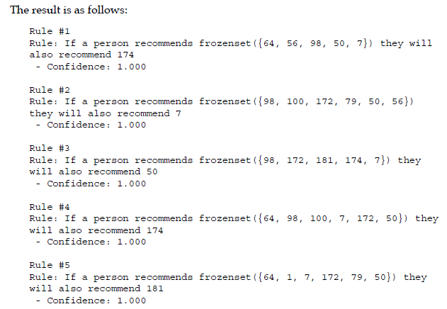
The result is as follow:

Slide 169
The resulting printout shows only the movie IDs, which isn't very helpful without the names of the movies also. The dataset came with a file called u.items, which stores the movie names and their corresponding MovieID (as well as other information, such as the genre).
We can load the titles from this file using pandas. Additional information about
the file and categories is available in the README that came with the dataset.
The data in the files is in CSV format, but with data separated by the | symbol;
it has no header and the encoding is important to set. The column names were
found in the README file.
movie_name_filename = os.path.join(data_folder, "u.item")
movie_name_data = pd.read_csv(movie_name_filename, delimiter="|",
header=None, encoding = "mac-roman")
movie_name_data.columns = ["MovieID", "Title", "Release Date","Video Release", "IMDB", "<UNK>", "Action", "Adventure","Animation", "Children's", "Comedy", "Crime", "Documentary","Drama", "Fantasy", "Film-Noir","Horror", "Musical", "Mystery", "Romance", "Sci-Fi", "Thriller","War", "Western"]

Slide 170
def get_movie_name(movie_id):
We look up the movie_name_data DataFrame for the given MovieID and return only the title column:
title_object = movie_name_data[movie_name_data["MovieID"] ==movie_id]["Title"]
title = title_object.values[0]
return title

Slide 171
In a new IPython Notebook cell, we adjust our previous code for printing out the top rules to also include the titles:
for index in range(5):
print("Rule #{0}".format(index + 1))
(premise, conclusion) = sorted_confidence[index][0]
premise_names = ", ".join(get_movie_name(idx) for idx in premise)
conclusion_name = get_movie_name(conclusion)
print("Rule: If a person recommends {0} they willalso recommend {1}".format(premise_names, conclusion_name))
print(" - Confidence: {0:.3f}".format(confidence[(premise,conclusion)]))
print("")

Slide 172
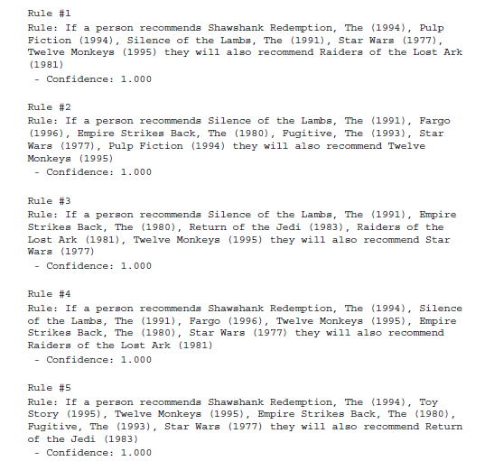
The result is much more readable (there are still some issues, but we can ignore them
for now):

Slide 173
Evaluation
In a broad sense, we can evaluate the association rules using the same concept as for classification. We use a test set of data that was not used for training, and evaluate our discovered rules based on their performance in this test set.
First, we extract the test dataset, which is all of the records we didn't use in the training set.
test_dataset =
all_ratings[~all_ratings['UserID'].isin(range(200))]
test_favorable = test_dataset[test_dataset["Favorable"]]
test_favorable_by_users = dict((k, frozenset(v.values)) for k, v
in test_favorable.groupby("UserID")["MovieID"])

Slide 174
We then count the correct instances where the premise leads to the conclusion, in the same way we did before. The only change here is the use of the test data instead of the training data.
Let's look at the code:
correct_counts = defaultdict(int)
incorrect_counts = defaultdict(int)
for user, reviews in test_favorable_by_users.items():
for candidate_rule in candidate_rules:
premise, conclusion = candidate_rule
if premise.issubset(reviews):
if conclusion in reviews:
correct_counts[candidate_rule] += 1
else:
incorrect_counts[candidate_rule] += 1

Slide 175
Next, we compute the confidence of each rule from the correct counts. Let's look at the code:
test_confidence = {candidate_rule: correct_counts[candidate_rule]
/ float(correct_counts[candidate_rule] + incorrect_counts[candidate_rule]) for candidate_rule in rule_confidence}

Slide 176
Finally, we print out the best association rules with the titles instead of the
movie IDs.
for index in range(5):
print("Rule #{0}".format(index + 1))
(premise, conclusion) = sorted_confidence[index][0]
premise_names = ", ".join(get_movie_name(idx) for idx in premise)
conclusion_name = get_movie_name(conclusion)
print("Rule: If a person recommends {0} they will also
recommend {1}".format(premise_names, conclusion_name))
print(" - Train Confidence:{0:.3f}".format(rule_confidence.get((premise, conclusion),-1)))
print(" - Test Confidence:{0:.3f}".format(test_confidence.get((premise, conclusion),-1)))
print("")

Slide 177
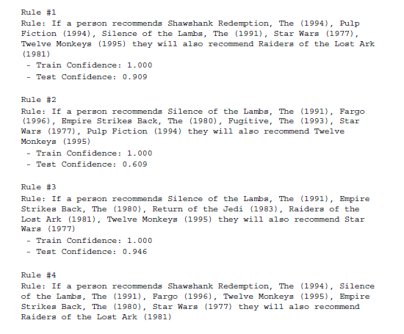
We can now see which rules are most applicable in new unseen data:

Slide 178
The second rule, for instance, has a perfect confidence in the training data, but it is only accurate in 60 percent of cases for the test data.
Many of the other rules in the top 10 have high confidences in test data though, making them good rules for making recommendations

Slide 179
Clustering Analysis
By HE WEI 2017.10.25

Slide 180
Obtaining news articles
In this experiment, we will build a system that takes a live feed of news articles and groups them together, where the groups have similar topics. You could run the system over several weeks (or longer) to see how trends change over that time.
Our system will start with the popular link aggregation website reddit, which
stores lists of links to other websites, as well as a comments section for discussion.
Links on reddit are broken into several categories of links, called subreddits.There are subreddits devoted to particular TV shows, funny images, and many other things. What we are interested in is the subreddits for news. We will use the /r/worldnews subreddit in this chapter, but the code should work with any other subreddit.
In this chapter, our goal is to download popular stories, and then cluster them to see any major themes or concepts that occur. This will give us an insight into the popular focus, without having to manually analyze hundreds of individual stories.

Slide 181
Reddit as a data source
Reddit (www.reddit.com) is a link aggregation website used by millions worldwide, although the English versions are US-centric. Any user can contribute a link to a website they found interesting, along with a title for that link.
Other users can then upvote it, indicating that they liked the link, or downvote it, indicating they didn't like the link. The highest voted links are moved to the top of the page, while the lower ones are not shown.
Older links are removed over time (depending on how many upvotes it has). Users who have stories upvoted earn points called karma, providing an incentive to submit only good stories.

Slide 182
Using the token we previously created, we can now obtain sets of links from a subreddit. To do that, we will use the /r/<subredditname> API endpoint that, by default, returns the Hot stories. We will use the /r/chinasubreddit:
subreddit = "worldnews"
url = "https://oauth.reddit.com/r/{}".format(subreddit)
Next, we need to set the headers. This is needed for two reasons: to allow us to use the authorization token we received earlier and to set the user agent to stop our requests from being heavily restricted. The code is as follows:
headers = {"Authorization": "bearer {}".format(token['access_token']),"User-Agent": USER_AGENT}
response = requests.get(url, headers=headers)

Slide 183
Calling json() on this will result in a Python dictionary containing the information returned by Reddit. It will contain the top 25 results from the given subreddit.
We can get the title by iterating over the stories in this response. The stories themselves are stored under the dictionary's data key. The code is as follows:
for story in result['data']['children']:
print(story['data']['title'])
Getting the data
Our dataset is going to consist of posts from the Hot list of the /r/worldnews subreddit.
We saw in the previous section how to connect to reddit and how to download links. To put it all together, we will create a function that will extract the titles, links, and score for each item in a given subreddit.

Slide 184
We will iterate through the subreddit, getting a maximum of 100 stories at a time. We can also do pagination to get more results. We can read a large number of pages before reddit will stop us, but we will limit it to 5 pages.
from time import sleep
def get_links(subreddit, token, n_pages=5):
stories = []
after = None
for page_number in range(n_pages):
result={}
url = "https://oauth.reddit.com/r/{}limit=100".format(subreddit)
headers = {"Authorization": "bearer {}".format(token['access_token']),"User-Agent": USER_AGENT}
if after:
url += "&after={}".format(after)

Slide 185
response = requests.get(url, headers=headers)
result = response.json()
after = result['data']['after']
sleep(2)
stories.extend([(story['data']['title'],story['data']['url'],story['data']['score'])
for story in result['data']['children']])
return stories

Slide 186
Extracting text from arbitrary websites
The links that we get from reddit go to arbitrary websites run by many different
organizations. To make it harder, those pages were designed to be read by a
human, not a computer program.
This can cause a problem when trying to get the actual content/story of those results, as modern websites have a lot going on in the background. JavaScript libraries are called, style sheets are applied, advertisements are loaded using AJAX, extra content is added to sidebars, and various other things are done to make the modern webpage a complex document.
These features make the modern Web what it is, but make it difficult to automatically get good information from!

Slide 187
Finding the stories in arbitrary websites
To start with, we will download the full webpage from each of these links and
store them in our data folder, under a raw subfolder. We will process these to
extract the useful information later on.
This caching of results ensures that we don't have to continuously download the websites while we are working. First, we set up the data folder path:
import os
data_folder = os.path.join(os.path.expanduser("~"), "Data",
"websites", "raw")
We are going to use MD5 hashing to create unique filenames for our articles, so we will import hashlib to do that.
import hashlib

Slide 188
If there is no error in the download, zero should be the output:
number_errors = 0
Next, we iterate through each of our stories:
for title, url, score in stories:
We then create a unique output filename for our article by hashing the title. Titles in reddit don't need to be unique, which means there is a possibility of two stories having the same title and, therefore, clashing in our dataset.
To get our unique filename, we simply hash the URL of the article using the MD5 algorithm.
While MD5 is known to have some problems, it is unlikely that a problem (a collision) will occur in our scenario, and we don't need to worry too much even if it does and we don't need to worry too much about collisions if they do occur.

Slide 189
output_filename = hashlib.md5(url.encode()).hexdigest()
fullpath = os.path.join(data_folder, output_filename + ".txt")
Next, we download the actual page and save it to our output folder:
try:
response = requests.get(url)
data = response.text
with open(fullpath, 'w') as outf:
outf.write(data)
If there is an error in obtaining the website, we simply skip this website and keep going.
This code will work on 95 percent of websites and that is good enough for
our application, as we are looking for general trends and not exactness.
except Exception as e:
number_errors += 1
print(e)

Slide 190
If you find that too many errors occur, change the print(e) line to just type
raise instead. This will cause the exception to be called, allowing you to debug the problem.
Now, we have a bunch of websites in our raw subfolder. After taking a look at these pages (open the created files in a text editor), you can see that the content is there but there are HTML, JavaScript, CSS code, as well as other content.
As we are only interested in the story itself, we now need a way to extract this information from these different websites.

Slide 191
Putting it all together
After we get the raw data, we need to find the story in each. There are a few online sources that use data mining to achieve this. You can find them listed in Appendix A,
Next Steps…. It is rarely needed to use such complex algorithms, although you can get better accuracy using them. This is part of data mining—knowing when to use it, and when not to.
First, we get a list of each of the filenames in our raw subfolder:
filenames = [os.path.join(data_folder, filename)
for filename in os.listdir(data_folder)]
Next, we create an output folder for the text only versions that we will extract:
text_output_folder = os.path.join(os.path.expanduser("~"), "Data",
"websites", "textonly")

Slide 192
Next, we develop the code that will extract the text from the files. We will use the lxml library to parse the HTML files, as it has a good HTML parser that deals with some badly formed expressions. The code is as follows:
from lxml import etree
Any node that has a type in this list will not be considered as containing the story. The code is as follows:
skip_node_types = ["script", "head", "style", etree.Comment]
def get_text_from_file(filename):
with open(filename,encoding='utf-8') as inf:
html_tree = LH.parse(inf)
return get_text_from_node(html_tree.getroot())
In the last line of that function, we call the getroot() function to get the root node of the tree, rather than the full etree. This allows us to write our text extraction function to accept any node, and therefore write a recursive function.

Slide 193
To check the text is at least 100 characters long.
The code is as follows:
def get_text_from_node(node):
if node == None:
return ""
if len(node) == 0:
# No children, just return text from this item
if node.text and len(node.text) > 100:
return node.text
else:
return ""
results = (get_text_from_node(child) for child in node if child.tag not in skip_node_types)
return "\n".join(r for r in results if len(r) > 1)

Slide 194
We can now run this code on all of the raw HTML pages by iterating through them, calling the text extraction function on each, and saving the results to the text-only subfolder:
for filename in os.listdir(data_folder):
text = get_text_from_file(os.path.join(data_folder, filename))
with open(os.path.join(text_output_folder, filename), 'w') as outf:
outf.write(text)
You can evaluate the results manually by opening each of the files in the text only subfolder and checking their content. If you find too many of the results have nonstory content, try increasing the minimum 100 character limit.
If you still can't get good results, or need better results for your application, try the more complex methods.

Slide 195
Grouping news articles
The aim of this chapter is to discover trends in news articles by clustering, or
grouping, them together.
To do that, we will use the k-means algorithm, a classic machine-learning algorithm originally developed in 1957.
Clustering is an unsupervised learning technique and we use clustering algorithms for exploring data.
Our dataset contains approximately 500 stories, and it would be quite arduous to examine each of those stories individually. Even if we
used summary statistics, that is still a lot of data.
Using clustering allows us to group similar stories together, and we can explore the themes in each cluster independently.

Slide 196
We use clustering techniques when we don't have a clear set of target classes for our data. In that sense, clustering algorithms have little direction in their learning.
They learn according to some function, regardless of the underlying meaning of the data. For this reason, it is critical to choose good features. In supervised learning, if you choose poor features, the learning algorithm can choose to not use those features.
For instance, support vector machines will give little weight to features that aren't useful in classification. However, with clustering, all features are used in the final result—even if those features don't provide us with the answer we were looking for.
When performing cluster analysis on real-world data, it is always a good idea to have a sense of what sorts of features will work for your scenario. In this experiment, we will use the bag-of-words model. We are looking for topic-based groups, so we will use topic-based features to model the documents. We know those features work because of the work others have done in supervised versions of our problem.

Slide 197
The k-means algorithm
The k-means clustering algorithm finds centroids that best represent the data using
an iterative process. The algorithm starts with a predefined set of centroids, which
are normally data points taken from the training data.
The k in k-means is the number of centroids to look for and how many clusters the algorithm will find.
For instance, setting k to 3 will find three clusters in the dataset. There are two phases to the k-means: assignment and updating. In the assignment step, we set a label to every sample in the dataset linking it to the
nearest centroid.
For each sample nearest to centroid 1, we assign the label 1. For each sample nearest to centroid 2, we assign a label 2 and so on for each of the k centroids.
These labels form the clusters, so we say that each data point with the label 1 is in
cluster 1 (at this time only, as assignments can change as the algorithm runs).
In the updating step, we take each of the clusters and compute the centroid, which
is the mean of all of the samples in that cluster.

Slide 198
The algorithm then iterates between the assignment step and the updating step; each time the updating step occurs, each of the centroids moves a small amount.
This causes the assignments to change slightly, causing the centroids to move a small amount in the next iteration. This repeats until some stopping criterion is reached. It is common to stop after a certain number of iterations, or when the total movement of the centroids is very low.
The algorithm can also complete in some scenarios, which means that the clusters are stable—the assignments do not change and neither do the centroids.

Slide 199
There is a k-means algorithm in scikit-learn, which we import from the cluster subpackage:
from sklearn.cluster import KMeans
We also import the CountVectorizer class's close cousin, TfidfVectorizer.
This vectorizer applies a weighting to each term's counts, depending on how many documents it appears in. Terms that appear in many documents are weighted lower (by dividing the value by the log of the number of documents it appears in).
For many text mining applications, using this type of weighting scheme can improve performance quite reliably.
The code is as follows:
from sklearn.feature_extraction.text import TfidfVectorizer

Slide 200
We then set up our pipeline for our analysis. This has two steps.
The first is to apply our vectorizer, and the second is to apply our k-means algorithm.
The code is as follows:
from sklearn.pipeline import Pipeline
n_clusters = 10
pipeline = Pipeline([('feature_extraction', TfidfVectorizer(max_
df=0.4)),('clusterer', KMeans(n_clusters=n_clusters))])
The max_df parameter is set to a low value of 0.4, which says ignore any word that occurs in more than 40 percent of documents.
This parameter is invaluable for removing function words that give little topic-based meaning on their own.

Slide 201
We then fit and predict this pipeline. We have followed this process a number of times in this book so far for classification tasks, but there is a difference here—we do not give the target classes for our dataset to the fit function.
This is what makes this an unsupervised learning task! The code is as follows:
pipeline.fit(documents)
labels = pipeline.predict(documents)
The labels variable now contains the cluster numbers for each sample. Samples with the same label are said to belong in the same cluster.
It should be noted that the cluster labels themselves are meaningless:
clusters 1 and 2 are no more similar than clusters 1 and 3.

Slide 202
We can see how many samples were placed in each cluster using the Counter class:
from collections import Counter
c = Counter(labels)
for cluster_number in range(n_clusters):
print("Cluster {} contains {} samples".format(cluster_number, [cluster_number]))
Many of the results (keeping in mind that your dataset will be quite different to mine) consist of a large cluster with the majority of instances, several medium clusters, and some clusters with only one or two instances.
This imbalance is quite normal in many clustering applications.

Slide 203
Evaluating the results
Clustering is mainly an exploratory analysis, and therefore it is difficult to evaluate a clustering algorithm's results effectively.
A straightforward way is to evaluate the algorithm based on the criteria the algorithm tries to learn from.
In the case of the k-means algorithm, the criterion that it uses when developing the centroids is to minimize the distance from each sample to its nearest centroid.
This is called the inertia of the algorithm and can be retrieved from any KMeans instance that has had fit called on it:
pipeline.named_steps['clusterer'].inertia_

Slide 204
The result on my dataset was 343.94. Unfortunately, this value is quite meaningless by itself, but we can use it to determine how many clusters we should use.
In the preceding example, we set n_clusters to 10, but is this the best value? The following code runs the k-means algorithm 10 times with each value of n_clusters from 2 to 20.
For each run, it records the inertia of the result.
We only fit the X matrix once per value of n_clusters to (drastically) improve the
speed of this code:
inertia_scores = []
n_cluster_values = list(range(2, 20))
for n_clusters in n_cluster_values:
cur_inertia_scores = []
X = TfidfVectorizer(max_df=0.4).fit_transform(documents)
for i in range(10):
km = KMeans(n_clusters=n_clusters).fit(X)
cur_inertia_scores.append(km.inertia_)
inertia_scores.append(cur_inertia_scores)

Slide 205
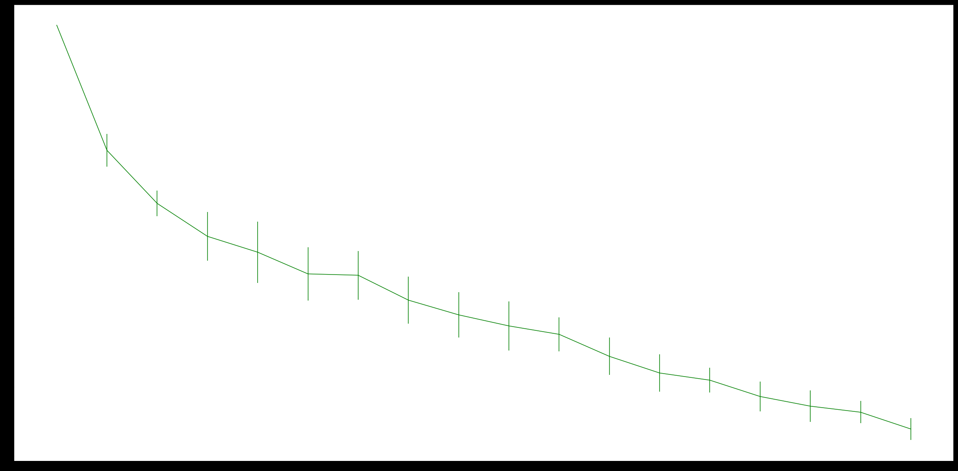
The inertia_scores variable now contains a list of inertia scores for each
n_clusters value between 2 and 20.
We can plot this to get a sense of how this value interacts with n_clusters:

Slide 206
Overall, the value of the inertia should decrease with reducing improvement as the number of clusters improves, which we can broadly see from these results.
The increase between values of 6 to 7 is due only to the randomness in selecting the centroids, which directly affect how good the final results are.
Despite this, there is a general trend (in these results; your results may vary) that about 6 clusters is the last time a major improvement in the inertia occurred.
After this point, only slight improvements are made to the inertia, although it is hard to be specific about vague criteria such as this.
Looking for this type of pattern is called the elbow rule, in that we are looking for an elbow-esque bend in the graph.

Slide 207
Extracting topic information from clusters
Now we set our sights on the clusters in an attempt to discover the topics in each.
We first extract the term list from our feature extraction step:
terms = pipeline.named_steps['feature_extraction'].get_feature_names()
We also set up another counter for counting the size of each of our classes:
c = Counter(labels)
Iterating over each cluster, we print the size of the cluster as before.
It is important to keep in mind the sizes of the clusters when evaluating the
results—some of the clusters will only have one sample, and are therefore not
indicative of a general trend.

Slide 208
The code is as follows:
for cluster_number in range(n_clusters):
print("Cluster {} contains {} samples".format(cluster_number,c[cluster_number]))
Next (and still in the loop), we iterate over the most important terms for this cluster.
To do this, we take the five largest values from the centroid, which we get by finding the features that have the highest values in the centroid itself.
The code is as follows:
print(" Most important terms")
centroid = pipeline.named_steps['clusterer'].cluster_centers_
[cluster_number]
most_important = centroid.argsort()

Slide 209
We then print out the most important five terms:
for i in range(5):
We use the negation of i in this line, as our most_important array is sorted with lowest values first:
term_index = most_important[-(i+1)]
We then print the rank, term, and score for this value:
print(" {0}) {1} (score: {2:.4f})".format(i+1, terms[term_index], centroid[term_index]))
The results can be quite indicative of current trends. In my results (March 2015), the clusters correspond to health matters, Middle East tensions, Korean tensions, and Russian affairs.
These were the main topics frequenting news around this time—although this has hardly changed for a number of years!

Slide 210
How it works
In the k-means algorithm, each feature is used without any regard to its weight. In essence, all features are assumed to be on the same scale. We saw the problems with not scaling features.
The result of this is that k-means is looking for circular clusters, as shown in the following screenshot:

Slide 211
As we can see in the preceding screenshot, not all clusters have this shape. The blue cluster is circular and is of the type that k-means is very good at picking up.
The red cluster is an ellipse. The k-means algorithm can pick up clusters of this shape with some feature scaling. The third cluster isn't even convex—it is an odd shape that k-means will have trouble discovering.
The EAC algorithm works by remapping the features onto a new space, in essence turning each run of the k-means algorithm into a transformer using the same principles we saw the previous section using k-means for feature reduction.
In this case, though, we only use the actual label and not the distance to each centroid.This is the data that is recorded in the co-association matrix.

Slide 212
The result is that EAC now only cares about how close things are to each other, not how they are placed in the original feature space. There are still issues around unscaled features.
Feature scaling is important and should be done anyway (we did it using tf-idf in this chapter, which results in feature values having
the same scale).

Slide 213
Reference:
Learning Data Mining with Python Robert Layton April 2017

Slide 214
Thank You!!

